Slide 1
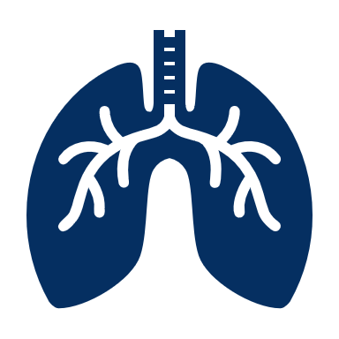
STRATEGIES IN Management OF RESPIRATORY DISTRESS
Ramona Herrington, BSRRT, AE-C
Jennifer Losgar, RRT, BS

Slide 2
INITIAL Treatment Goals IN TREATING RESPIRATORY DISTRESS
Prevent Invasive Ventilation if possible
Decrease work of breathing
Improve Oxygenation and Ventilation

Slide 3
Signs of respiratory distress
Irregular respiratory rate
Accessory muscle use
Nasal Flaring
Tripoding
Decreased oxygen saturation
Cyanosis
Wheezing

Slide 4
TYPES OF NON-INVASIVE TREATMENTS
High Flow Oxygen Devices
Venturi Mask - up to .50 Fi02
Misty OX Aerosol Mask - Can deliver 60 - 96% oxygen
Non Rebreather (NRB) - can deliver up to 95% oxygen at a flow rate set at 10 - 15 L/M
HFNC - High Flow Nasal Cannula
NIV - Non Invasive Ventilation

Slide 5
High Flow Nasal Cannula
Start with flow of 50 – 60 L/M or patient need, Fi02 1.0
Goal is to meet patient drive to breath with this high flow device. As we meet demand, work of breathing and RR should decrease. ABG in 1 hour.
As patient improves, start weaning oxygen levels in increments of 10 down to 40% or 30%, then wean flow to 30 L/M in increments of 10 L/M.
We may wean the flow with the Fi02 depending on the flow demand of the patient.
If patient does not improve or gets worse, escalate to NIV if there are no contraindications - needs to be awake and alert to protect airway

Slide 6
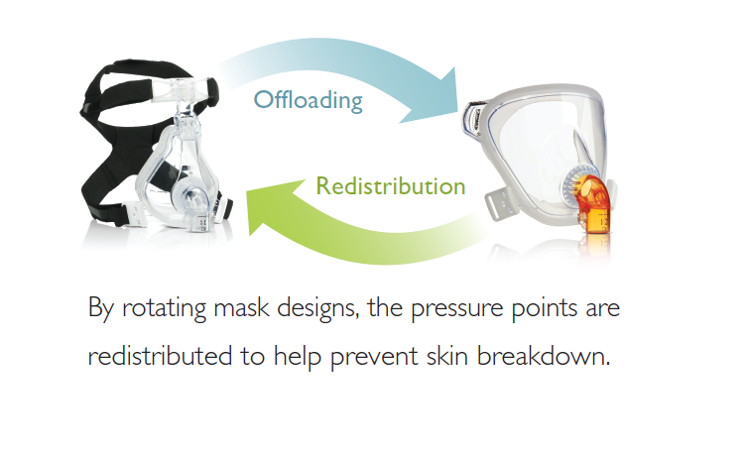
non-Invasive ventilation
Place patient on NIV if patient does not improve on HFNC and no contraindications
Start with a spontaneous mode which is more comfortable in the awake patint - Pressure Support 10 cmH20 and adjust for an adequate Vte ~ 6-8 ml/Kg IBW, start PEEP 8 cmH20 or level to achieve acceptable Sp02, Fi02 1.0, obtain ABG 30 minutes – 1 hour later.
If PS does not satisfy patient’s demand, place on full ventilatory mode. PC is the only full ventilatory mode for NIV on the Servo I, which is the brand of ventilator we use in our hospital.
If the patient does not improve after an hour or 2 on NIV, then patient needs to be intubated

Slide 7
Niv contraindications
Excessive amount of respiratory secretions
Nausea/vomiting OR High risk for aspiration
Cardiac/respiratory arrest
Hemodynamic instability ( not responsive to fluids/pressors)
Uncontrolled arrhythmias
Severe upper GI bleeding
Acute sinusitis
Inability to cooperate with procedure/unable to fit mask properly
Recent facial surgery/facial trauma/or deformity OR Recent Esophageal surgery
Recent upper GI and/or airway surgery
Agonal breathing/ apnea
Epistaxis
Active hemoptysis
Known or suspected tympanic membrane rupture or another middle ear pathology
Untreated pneumothorax
Full Stomach
NEVER TIE PATIENT HANDS AND FORCE TO COOPERATE

Slide 8
Ventilator Protocols
Restrictive/ARDS
Obstructive/COPD
General/Surgical

Slide 9
Mechanical Ventilation Basics
CO2 management is affected by manipulation of RR and tidal volume
- maintain adequate minute ventilation per disease strategy
PO2 management is affected by manipulation of FiO2, PEEP, I time - any variable that increases Paw (mean airway pressure)
- be mindful of peak pressures with higher PEEP settings
-- can affect hemodynamics
Normal I:E ratio is 1:2.0
- ARDS < 1:2.0 (can use 1:1 or inverse ratio)*
- COPD > 1:2.0
*Use caution*

Slide 10
Restrictive/ARDS Protocol
- lower tidal volume 4 - 6 ml/kg IBW to maintain plat <30
- higher PEEP for lung recruitment
- Inverse I:E ratio (increase the I time or decrease flow)
- Driving Pressure (plateau - PEEP) <15 - 18 – Association studies reveal better outcomes in patients with ARDS in comparison to Plateau and high PEEP
- Paralytics - use in spontaneous ventilation and dysynchrony in early phases of ARDS to prevent patient self inflicted lung injury (P-SILI)
- Prone early in severe ARDS in pts with P/F < 150 mmHg if no improvement with PEEP, I-time and paralytics. Prone 16 hours alternating with supine 8 hours

Slide 11
Obstructive/COPD protocol
- lower RR and lower I-time(or higher flow) to allow for increased expiratory phase
- Longer expiratory time I:E 1:3 or 1:4
- be cautious of Auto-PEEP
- use bronchodilators, steroids and anticholinergics

Slide 12
General/surgical Protocol
- 6-8 ml/kg IBW ventilation - use 7 - 8 ml/kg IBW to prevent atelectasis while keeping plateau <30 and Driving pressure < 15
- For intubated obese patients (BMI >30 kg/m2) use formula BMI/4 for adequate PEEP levels - conservative guide to set initial PEEP in obese patients in centers without the ability to do esophageal manometry
- normal I:E ratio

Slide 13
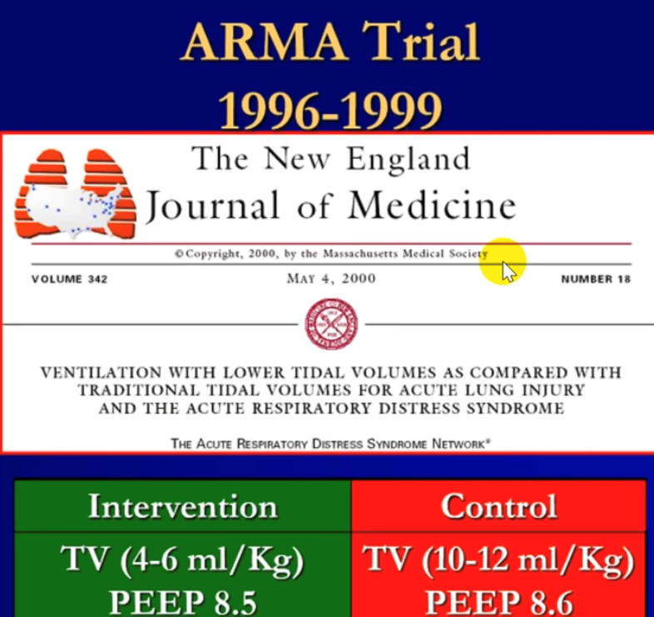

Slide 14
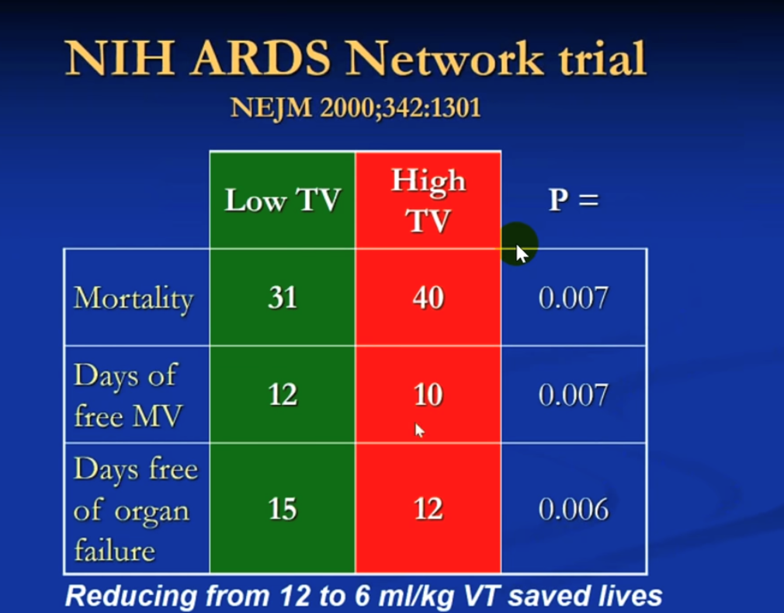

Slide 15
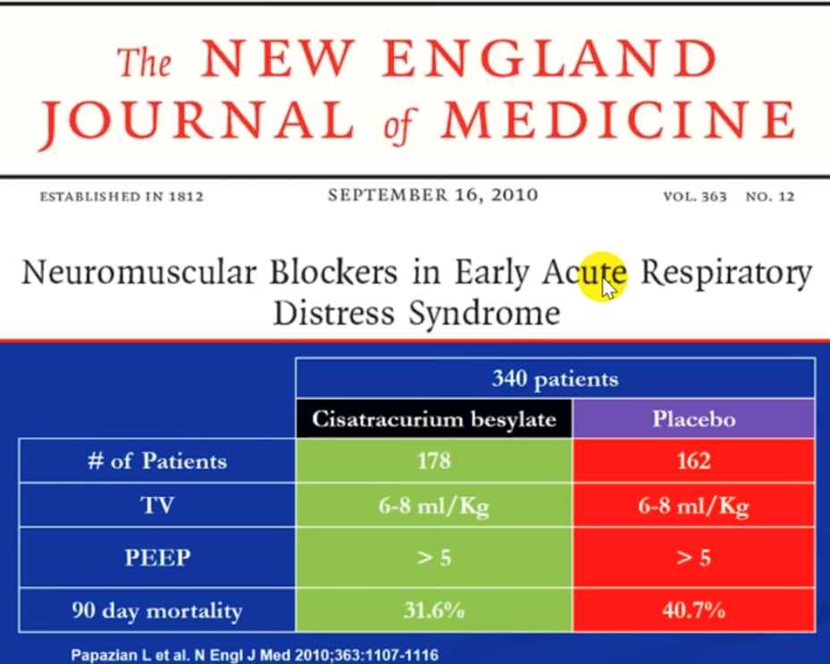

Slide 16
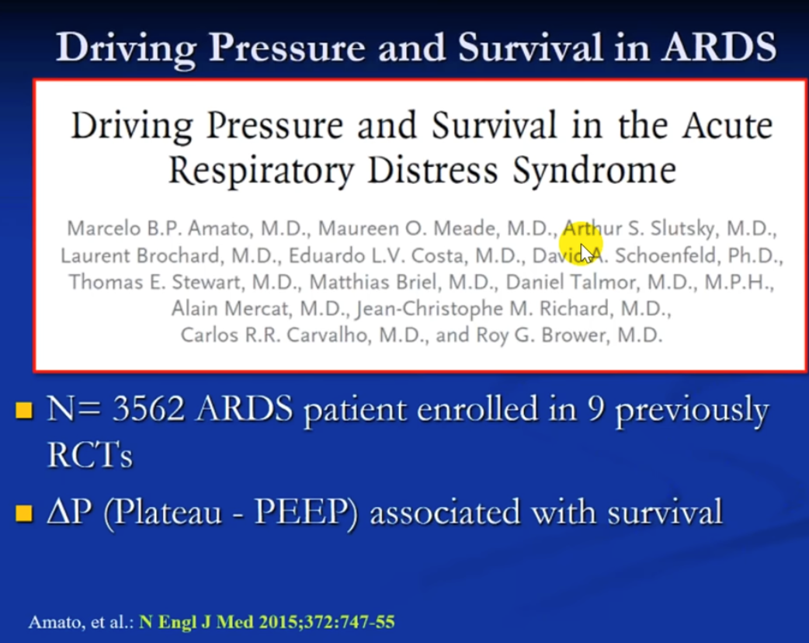

Slide 17
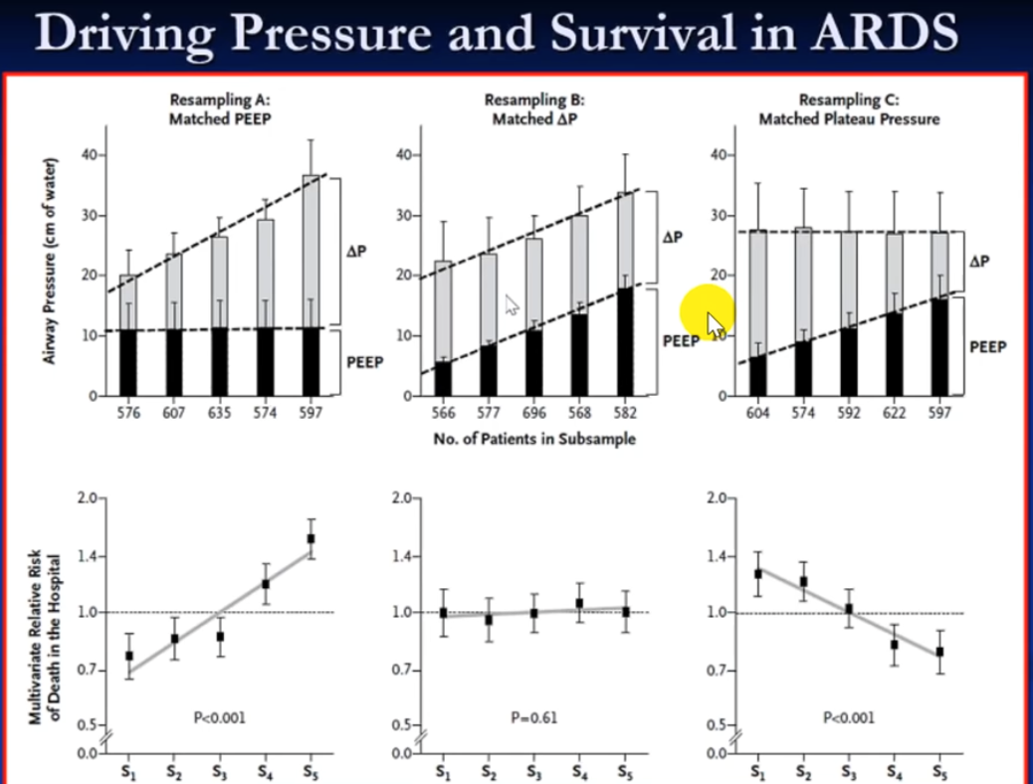

Slide 18
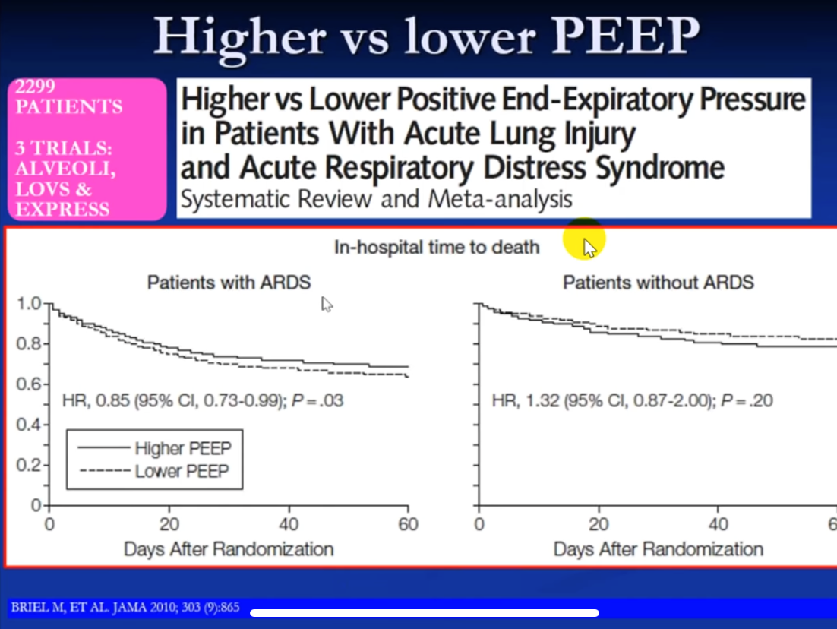

Slide 19
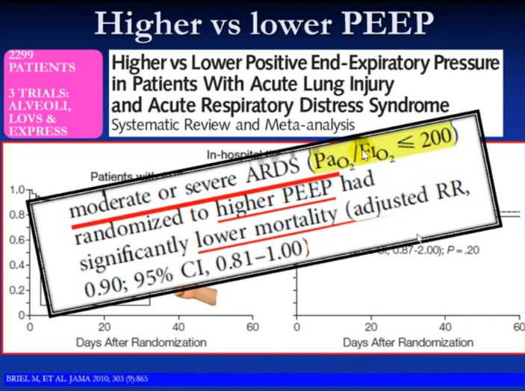

Slide 20
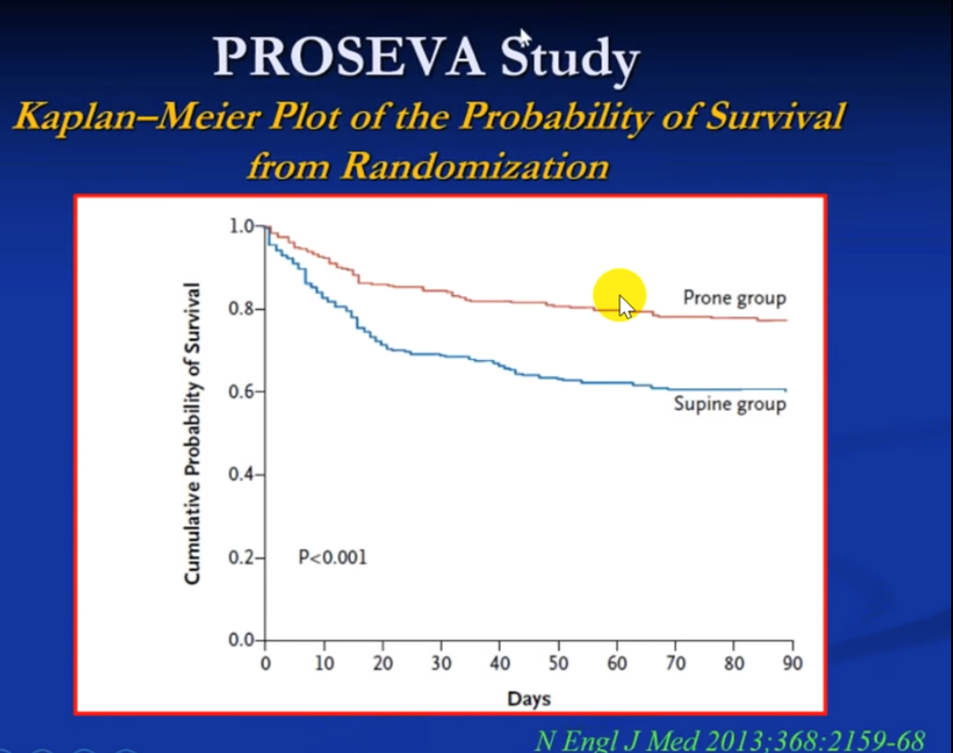

Slide 21
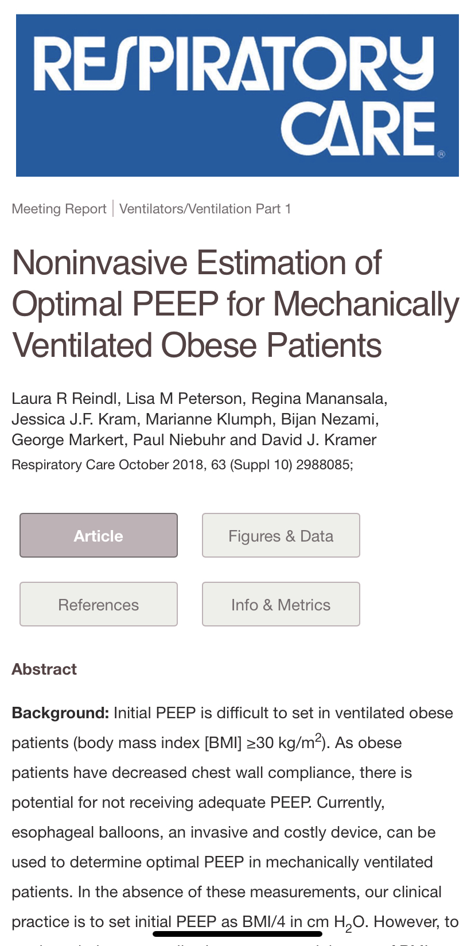

Slide 22
