Slide 1
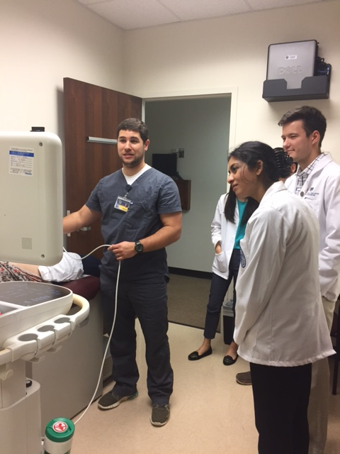
Clinical Ultrasound Orientation
Class of 2024
Clerkship Ultrasound Requirements
Becky J. Etheridge, EdD, RDMS, November 2021

Slide 2
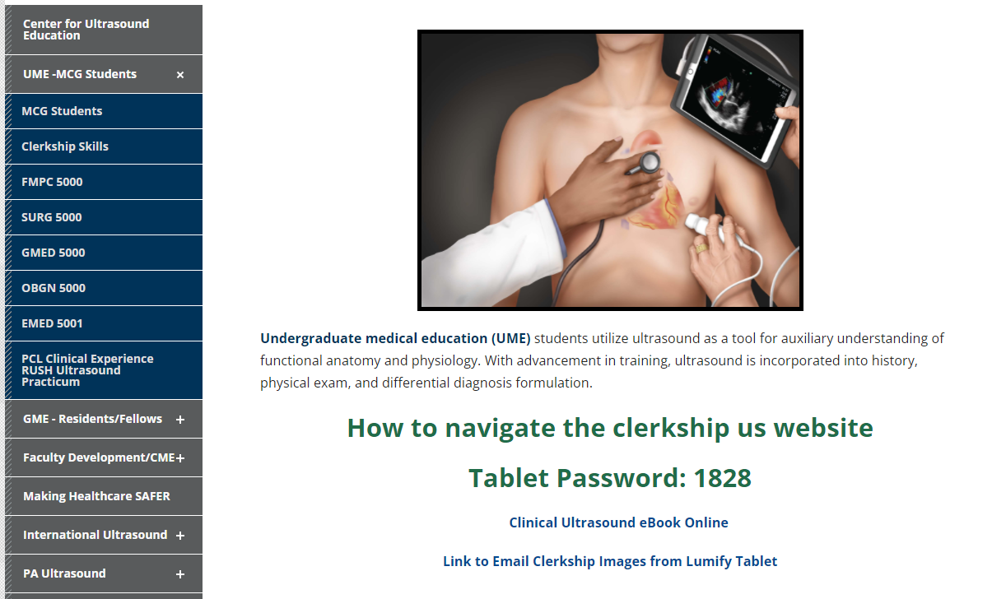
MCGUltrasoundEducation.com
Click “MCG Students”
Dr. Lyon’s US Website Video
Tablet Password: Founding Year of MCG (on Lab Coat)
Link to Dr. Lyon’s eBook
Link to Email Clerkship Images from Lumify Tablet

Slide 3
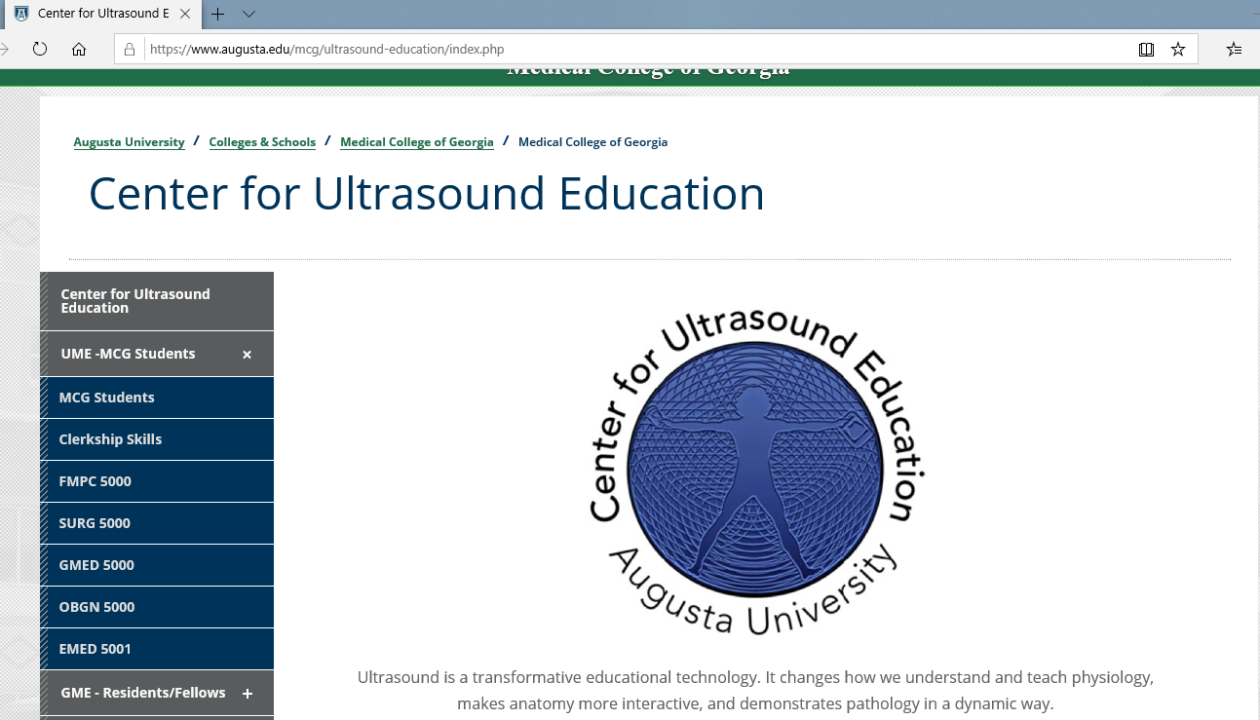
MCGUltrasoundEducation.com
Website Navigation Video & Lumify PW
Clinical Procedures Videos
Specific Clerkship Web Pages

Slide 4
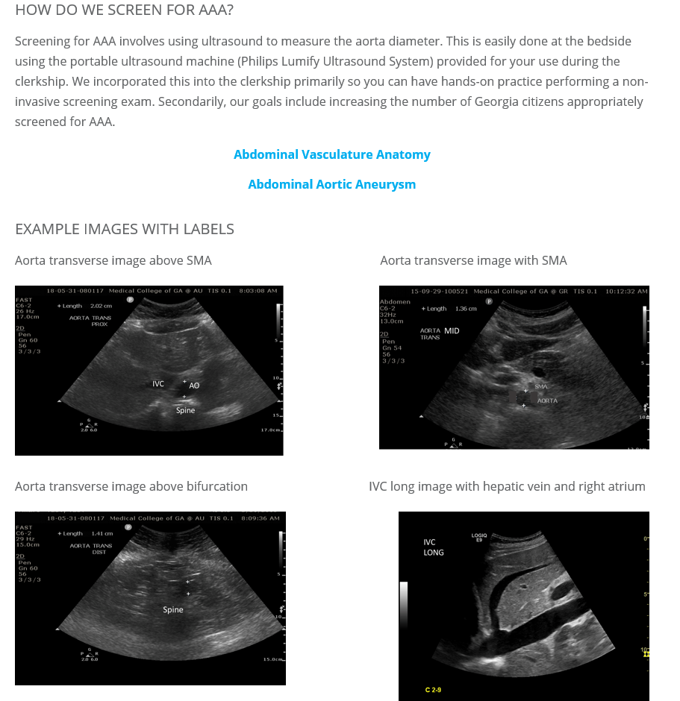
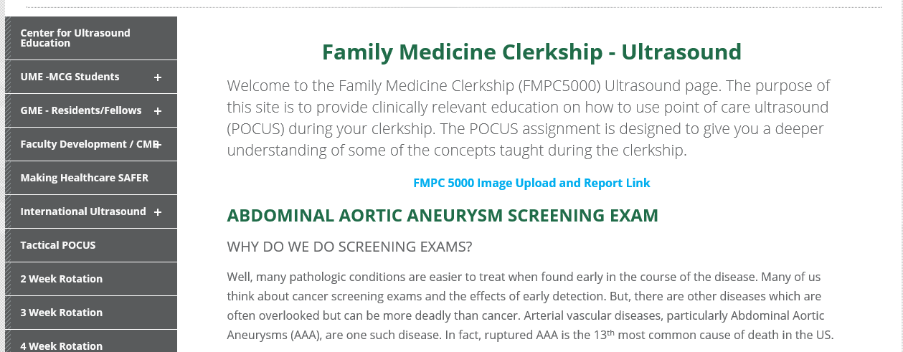
MCGUltrasoundEducation.com
Normal and Pathology Videos
Image Upload and Report Link
Example Images with Labeling / Measurements

Slide 5
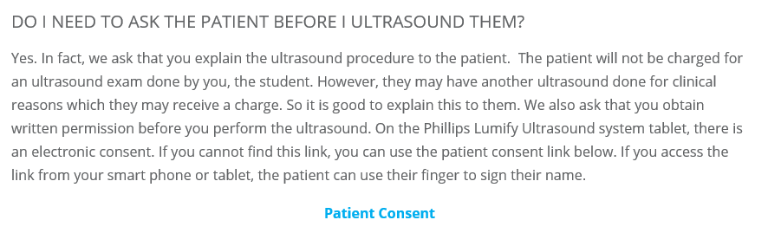
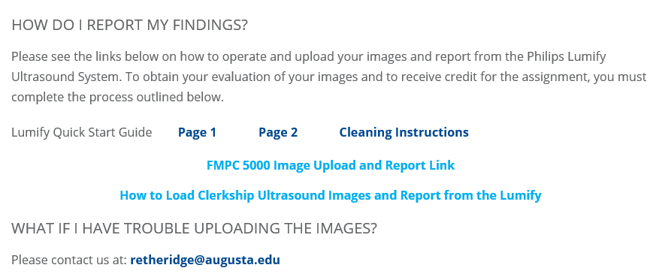
MCGUltrasoundEducation.com
Online Patient Consent
Lumify Guide, Cleaning, and Lumify Upload Instructions
My Contact Info (706-721-2262)

Slide 6
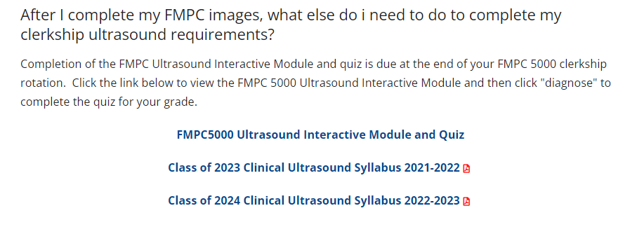
MCGUltrasoundEducation.com
Interactive Ultrasound Module and 2 Question Quiz
Clinical Ultrasound Curriculum Information

Slide 7
What US Equipment to use?
Augusta
Regional Campuses
Family Medicine – ALL Clerkship sites have an assigned Lumify that stays at site
OB/GYN – ALL Clerkship sites have US equipment for student use
Surgery – Students use hospital US equipment (Ms. Simpson has 2 Lumifys)
Internal Medicine - Students use hospital US equipment (Ms. Jones has 2 Lumifys)
Emergency Medicine – ALL Clerkship sites have US equipment for student use
Family Medicine – ALL Clerkship sites have an assigned Lumify that stays at site
OB/GYN – ALL Clerkship sites have US equipment for student use
Surgery – Students use hospital US equipment or Lumify checkout from regional campus coordinators
Internal Medicine - Students use hospital US equipment or Lumify checkout from regional campus coordinators
Emergency Medicine – ALL Clerkship sites have US equipment for student use

Slide 8
What is due and when?
Specific # Set of patient images with report (Etheridge, LaRavia Feedback Email)
Review of Interactive Ultrasound Module and 2 Question Quiz

Slide 9
Suggestions
Scan actual patients!!!! (EM and OB have specific report requirements)
Scan more than one area on each patient
Images must include your name, date, and time on US machine
Do not share images or submit other student images
Compare your images to example images

Slide 10

Good Luck and Keep in Touch!

