Slide 1
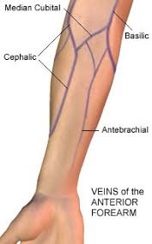
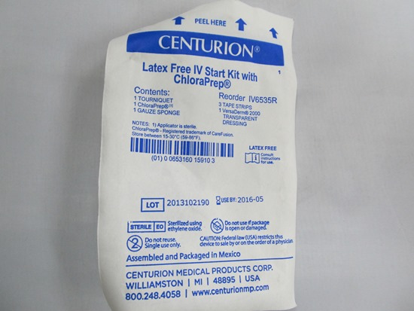
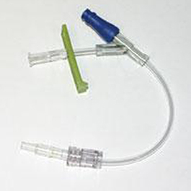
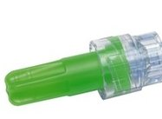
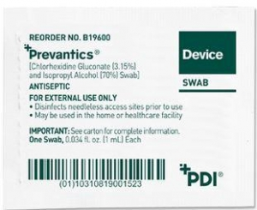
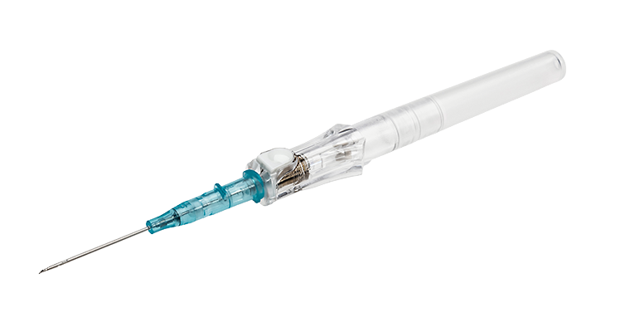
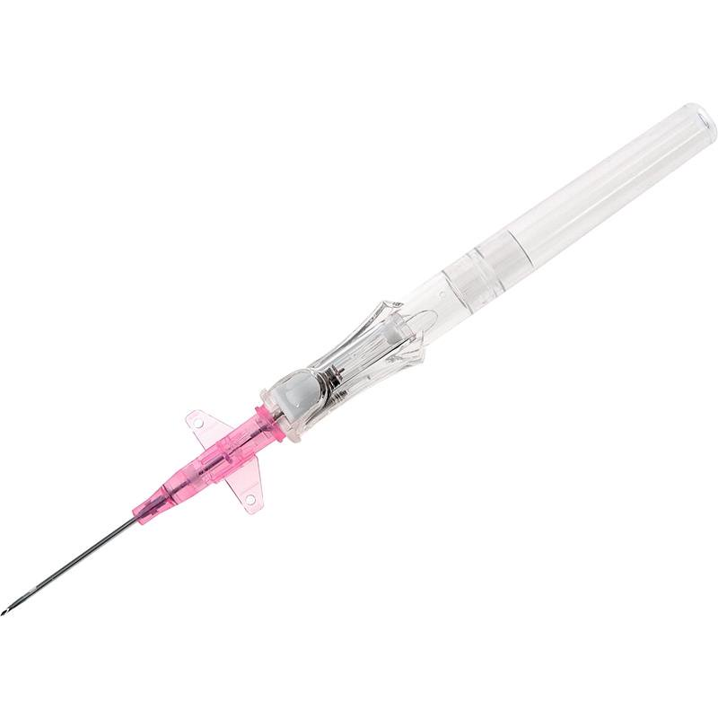
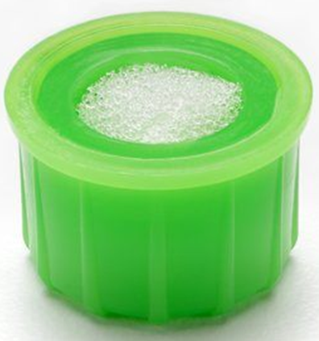
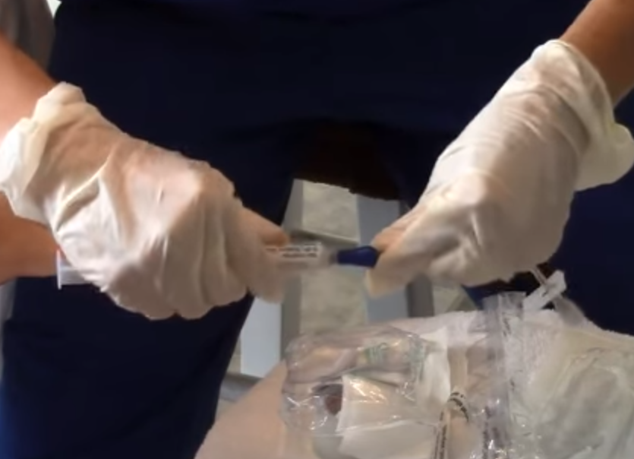
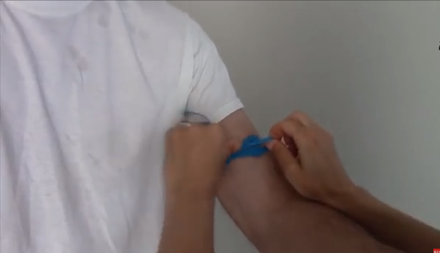
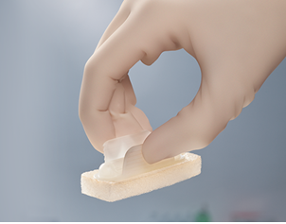
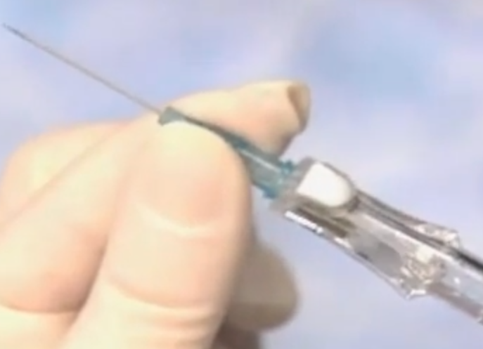
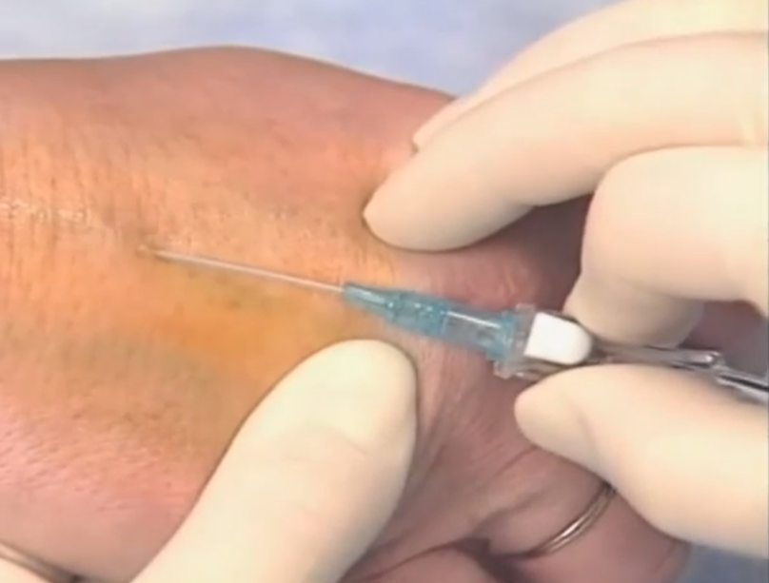
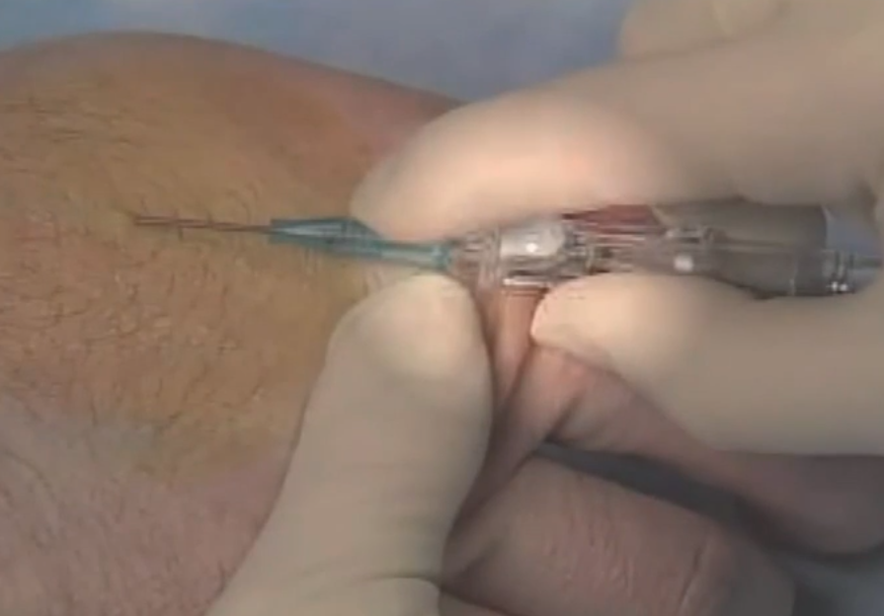
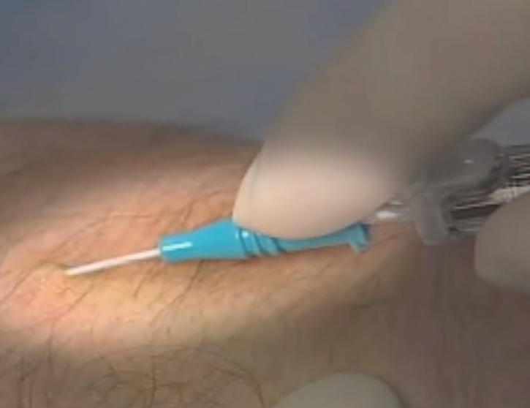
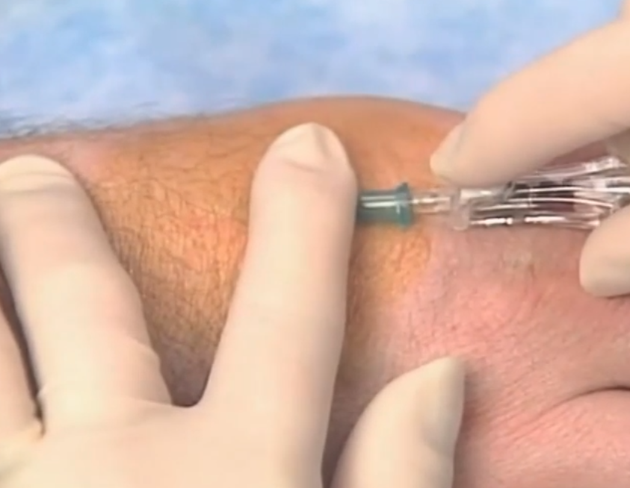
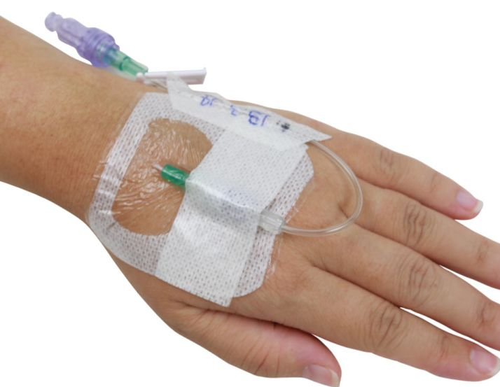
Making Procedures SAFER
Peripheral IV Insertion
Indications for placement
Catheter Color | Catheter Size
 | 14 gauge
 | 16 gauge
 | 18 gauge
 | 20 gauge
 | 22 gauge
 | 24 gauge
Only peripheral access is required for treatment
Good Peripheral Access
< 10% Dextrose Ordered
No TPN ordered
Average size needed for patient care is 20 gauge
Procedural Considerations
Preferred insertion site for a PIV is the upper extremity.
Avoid pre- and post-operative sites, areas that are edematous , injured/damaged, the arm on the same side as a past/potential mastectomy, paralysis, or dialysis fistula.
Unless necessary or only site available, the antecubital space should be used if unable to obtain other sites.
If unable to obtain access after 2 attempts, ask for assistance from another member of the medical team.
Equipment
Patient Preparation
Appropriate gauge angiocatheter
IV Start Kit
Extension IV tubing Set
Curos caps and Prevantics wipes
Select the appropriate catheter size to best meet the needs of the patient.
PERFORM HAND HYGEINE!
Position the patient appropriately: Arm down by side with forearm resting slightly off the edge of bed.
Even peripheral IVs require an order in PowerChart.
Procedure
1
Gather equipment and bring it to the bedside.
Make sure to prime the extension tubing with normal saline BEFORE starting the procedure.
2
Position the patient’s arm by their side, allowing it hang slightly off the edge of bed.
Apply tourniquet to upper arm. Extended tourniquet times can hemolyze lab results.
3
Look and feel for a vein either in the hand, forearm, or AC.
Once site is determined, clean site using Chloraprep applicator in start kit and DO NOT TOUCH AFTER!
4
Take cap off of catheter and turn the hub 360’ to break the seal.
The white button should be right-side up, be careful not the press the button as this activates the safety button.
5
Remember to not touch site as it is clean.
Using non-dominant hand, place thumb below the intended insertion site and pull the skin/vein down.
6
Ensure that the bevel is up, and insert the needle at a 30’ angle.
Look for flashback in the catheter and in the chamber under the white button.
7
Once flash is seen, lower the angle and advance the needle and catheter slightly.
To advance the catheter, use the notch in the middle to hub the catheter at the insertion site.
8
Apply pressure 2 finger lengths above insertion site to occlude vein to reduce blood loss with needle removal.
Press the white button to engage the safety mechanism/withdrawal needle into chamber.
9
Hook primed tubing to catheter and clean any blood around site.
Place the dressing, ensuring the hub is secure. Date, time, and initial dressing.
Post
Procedure
Place sharps in sharps box and clean up supplies.
If site blows, DO NOT STICK below the site blown. Another attempt must be made ABOVE the site to prevent medication from leaking into surrounding tissue.
Notify RN of IV placement (site & gauge), if successful.
Cover all access ports with Curos caps and scrub the hub with Prevantics wipes before using.
Lab samples must be labeled at bedside. In select adult populations (i.e. CT patients), consider using pediatric tubes.

