Slide 1
Simvastatin and Prostate Cancer: Biochemical Changes and Clinical Implication
Thomas Kochuparambil
09/14/10

Slide 2
Background
Why did we chose this study ?

Slide 3
Summary of four clinical studies that associated statins with reduced risk of advanced prostate cancer
STUDY | DESIGN | n | RR for overall prostate cancer (95% CI) | RR for advanced prostate cancer (95% CI)
Health Professionals Follow-up Study | Prospective cohort of surveyed male health professionals throughout the US | 34,989 | 0.85 (0.71–1.03) | 0.26 (0.08–0.83)
Cancer Prevention Study II– Nutrition | Prospective cohort of surveyed males throughout the US | 55,454 | 1.06 (0.93–1.20) | 0.60 (0.36–1.00)
California Men’s Health Study | Prospective cohort of surveyed male in California. | 69,047 | 0.72 (0.53–0.99) | 0.57 (0.23–1.40)
Finnish Population Study | Prospective case control using Finnish Cancer Registry | 24,723 (matched pairs) | 1.16 (1.03–1.31) | 0.71 (0.48–1.07)

Slide 4
Prostate cancer and PSA among Statin users in the Finnish trial
Murtola TJ, Tammela TL, Määttänen L, Huhtala H, Platz EA, Ala-Opas M, Stenman UH, Auvinen A.
23,320 men : Finnish prostate cancer screening trial during 1996-2004.
Overall decreased incidence of prostate cancer among statin users [HR 0.75, 95% confidence interval (CI) 0.63-0.89].
The inverse association was dose-dependent with cumulative amount of statin use, and strongest for low-grade and early stage tumors.
The incidence was non significantly lower also among users of other types of cholesterol-lowering drugs (HR 0.62, 95% CI 0.28-1.38) and other common meds like COX2-I , Metformin.
Overall incidence of prostate cancer was lowered among statin users when bias due to differential PSA testing between eliminated by systematical prostate cancer screening.

Slide 5
STATIN’S
Statins are a class of medication that inhibits HMG-CoA reductase, which catalyses the rate limiting step in cholesterol synthesis.
They are the second most prescribed therapeutic drug class in the United States after analgesics.
National Health and Nutrition Exam Survey estimates that 57.9% of older adults (men >or=50 years and women >or=60 years), or 33,547 000 Americans are taking a statin .

Slide 6
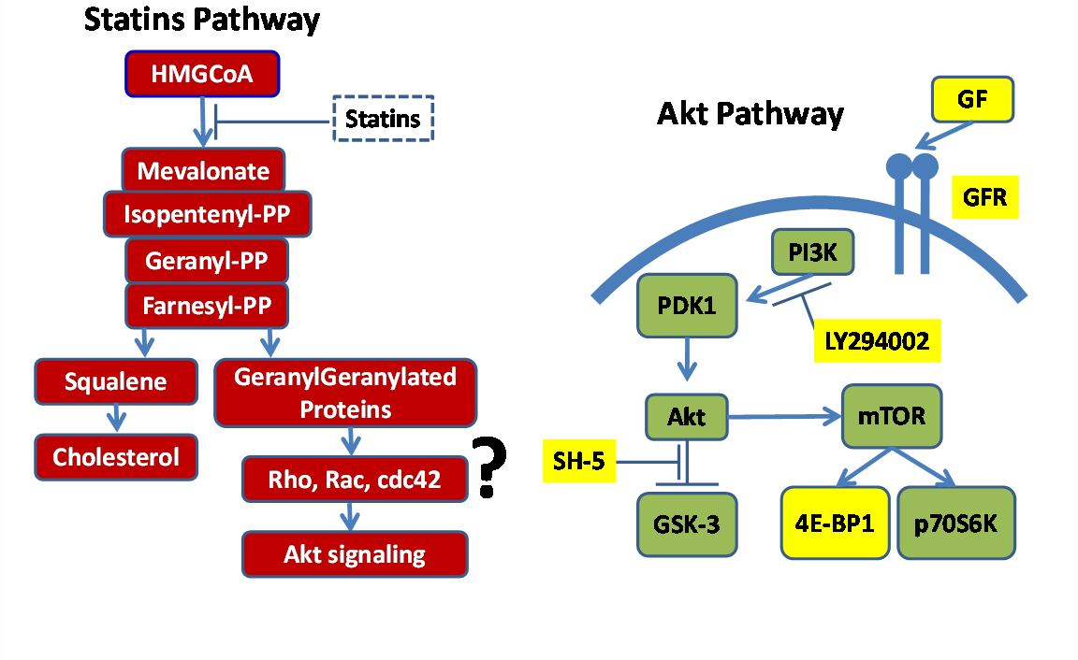
PATHWAYS

Slide 7
Akt Signaling Pathway
Akt is central to many signaling pathways and is
a known mediator of many functions of cancer
cells . Our study has indicated that Akt activation
results in enhanced tumorgenicity of prostate
cancer cells (Goc A, Al Husein BH, Kochuparambil ST, Shenoy PR; communicated).
Hence we sought to determine whether
treatment with simvastatin will have any effect on
phosphorylation and activity of Akt.

Slide 8
Does simvastatin affect phosphorylation of Akt ?
Western Blot Analysis
YES
Does this change translate to change in behavior of the tumor ?
Migration , Invasion , Proliferation ,
Apoptosis , Foci formation .
YES
Can this change be reversed if Akt is over expressed (constitutively active) ?
Myr Akt
YES

Slide 9
Can this effect be reproduced In Vivo ?
Nude Mice Xenograft- Wt, Size, Growth, PSA level.
Yes
Are the same effects seen in patients ?
Work in progress
?
Prospective Clinical trial ?
Work in Progress
?

Slide 10
Cholesterol Independent Effect

Slide 11
Bio Chemical Analysis
Does simvastatin affect phosphorylation of Akt ?
Western Blot
Yes
Prostate Cancer Cell Lines/Cell Culture
PC 3(Cholesterol pathway Independent)
Inhibition of Akt in a “Time” and “Dose” dependent Manner.
LnCaP (Cholesterol pathway Sensitive)

Slide 12






Figure 1
LnCaP Cells (Cholesterol pathway Sensitive)
A
B
C
10
25
50
75
100
µM
C
25
100
C
25
100
µM
pS473-Akt
pS473-Akt
p-GSK3α/β
p-GSK3
Akt
β-Actin
β-Actin
Simvastatin (16h)
Simvastatin (4h)
Simvastatin (16h)
PC3 Cells (Cholesterol pathway Independent)
C
C
25
C
25
C
25
C
25
µM Simvastatin
pS473-Akt
P Akt is inhibited in time as well as dose dependent manner
β-Actin
pAkt/β-actin
Time (h)

Slide 13
Simvastatin treatment inhibits Akt pathway in human prostate cancer cells
A: A dose-dependent (10, 25, 50, 75 and 100 µM) study on the effects of simvastatin (16h) on phosphorylation of Akt and its downstream substrate GSK-3 α and β in LNCaP cells.
B: Time-course effect of 25 µM simvastatin (4 and 16h) on Akt and GSK-3 phosphorylation in LNCaP cells.
C: Time-course effect of 25 µM simvastatin (4, 8, 16 and 24h) on Akt phosphorylation in PC3 cells. Corresponding densitometry values normalized to β-actin are shown below.

Slide 14
Does simvastatin affect phosphorylation of Akt ?
Western Blot Analysis
YES
Does this change translate to change in behavior of the tumor ?
Migration , Invasion , Proliferation ,
Apoptosis , Foci formation .
YES
Can this change be reversed if Akt is over expressed (constitutively active) ?
Myr Akt
YES

Slide 15
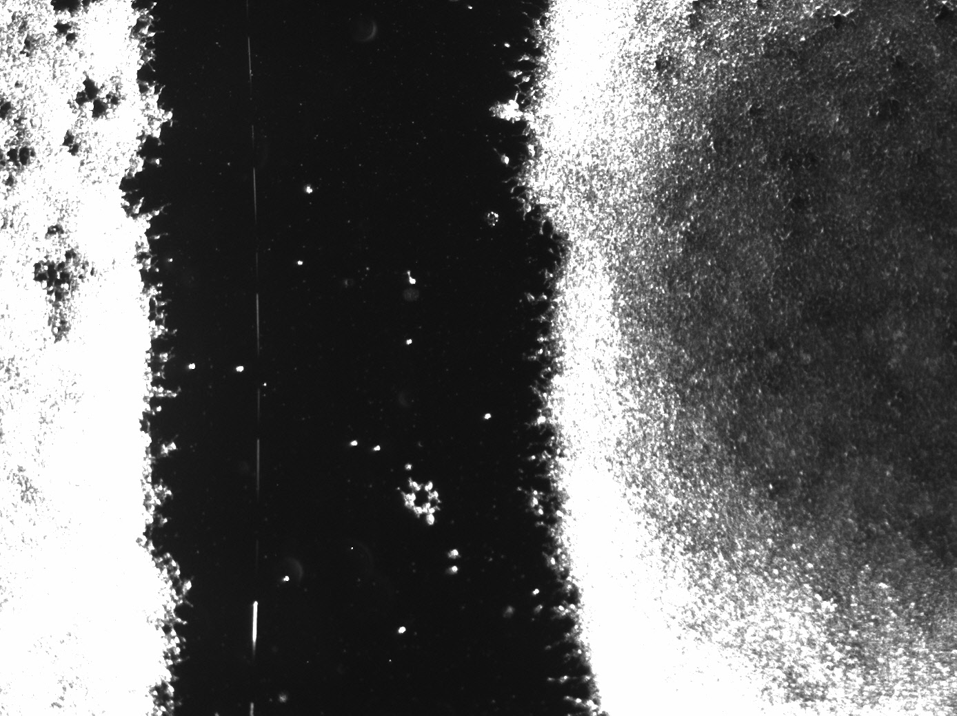
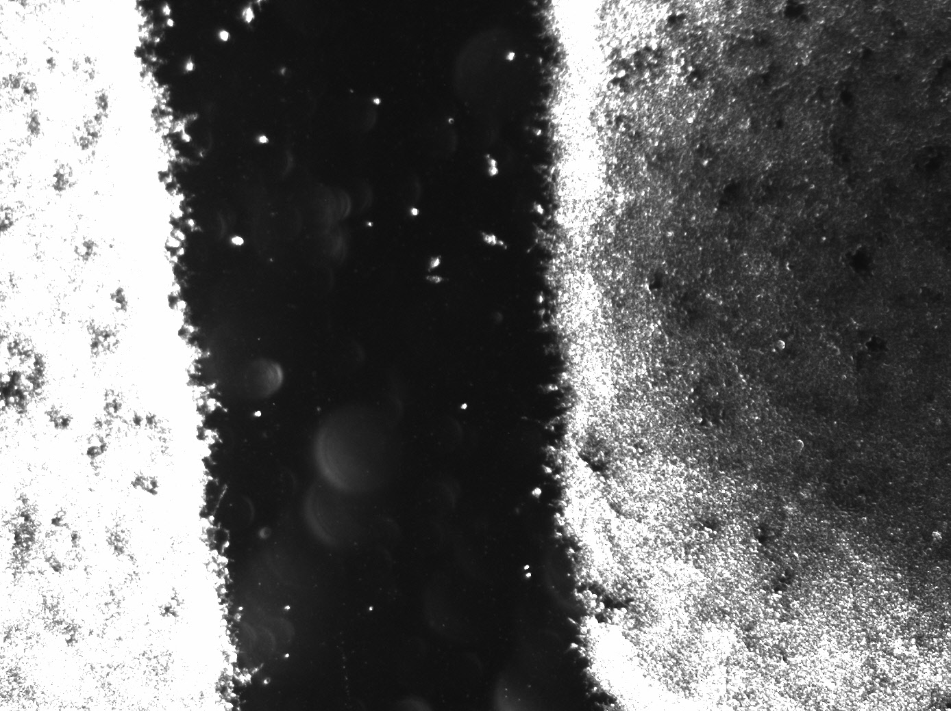
Migration Assay
Measured after 24 hours
Simvastatin
Control
0.23mm
0.19mm
Simvastatin Inhibits Migration of PC 3 cells

Slide 16
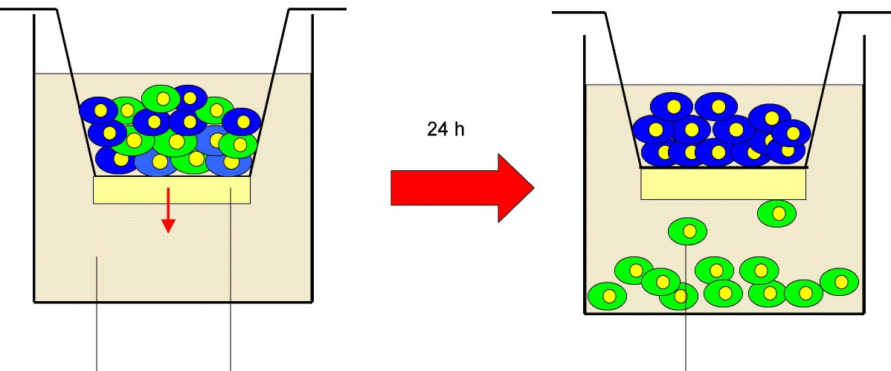
Invasion Assay
Prostate Cancer cells
Matri gel Membrane
Simvastatin
Control
Simvastatin Inhibits invasion of PC 3 cells
Representative Image

Slide 17
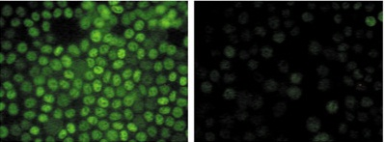
Doubling Time &Proliferation Assay
Control Simvastatin
Inhibition of Proliferation
Simvastatin Inhibits Proliferation of PC 3 cells
Representative Image

Slide 18
Figure 2
Simvastatin Inhibits Migration and Invasion of PC 3 cells
A
B
n = 4
n = 4
p < 0.04
p < 0.04
p < 0.05
p < 0.0002
p < 0.001
p < 0.001
Simvastatin (16h)
Simvastatin (24h)
D
p < 0.01
n = 3
n = 4
p < 0.005
p < 0.003
p < 0.005
p < 0.0002
p < 0.03
25
100
Simvastatin (µM)

Slide 19
Figure 3
Simvastatin Inhibits Proliferation of PC 3 cells
A
B
n = 4
n = 4
p < 0.00001
p < 0.001
p < 0.0003
Doubling time (hours)
p < 0.0003
Control
25
100
25
100
Simvastatin (µM)
Notes:
Samith’s lab book → Doubling time count cells in hundred’s range

Slide 20
Simvastatin inhibits PC3 cell proliferation
A Actively growing PC3 cells were plated in 96-well plates at a density of 1x10⁴ cells/well in triplicates. After 24h incubation in a CO₂ incubator at 37ºC, cells were treated with 25 and 100 µM simvastatin for 16h. Cell counts were performed at 0 and 24h time points and doubling time was calculated.
B Actively growing PC3 cells were plated in 96-well plates at a density of 1x10⁴cells/well in triplicates. After 24h incubation in a CO₂ incubator at 37^{O}C, cells were treated with the indicated concentrations of 25 and 100 µM Simvastatin for 16h. In Control cell DMSO was used. Cell proliferation was determined by the BrDU exclusion assay. Bar graph shows the percentage inhibition of proliferation in simvastatin treated PC3 cells normalized to saline.

Slide 21
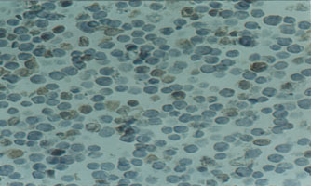
Apoptosis /Cell Viability
Trypan Blue Staining
Blue Non Viable Cells
Viable Cells
Simvastatin induces non specific cell death in PC 3 cells
Representative Image

Slide 22
Figure 4
Simvastatin induces non specific cell death and apoptosis in PC 3 cells
A
B
n = 4
p < 0.0001
p < 0.0001
Control
25
100
25
100
Simvastatin (µM)
Simvastatin (µM)

Slide 23
Simvastatin induces Apoptosis in PC3 cells
A Cell viability was measured using trypan blue exclusion method. PC3 and LNCaP cells were grown to confluence and treated with simvastatin (25, 50 and 100 µM) for 24h.Cells then were collected, re-suspended in PBS with 0.4% Trypan blue solution. Total cells and Trypan Blue stained cells were counted separately and percentage of non viable cells were calculated.
B PC3 cells were treated with 25 and 100 µM simvastatin for 16h and subjected for apoptosis assay. Bar graph shows the fold increase in apoptosis in simvastatin treated PC3 cells compared to saline control.

Slide 24
Does simvastatin affect phosphorylation of Akt ?
Western Blot Analysis
YES
Does this change translate to change in behavior of the tumor ?
Migration , Invasion , Proliferation ,
Apoptosis , Foci formation .
YES
Can this change be reversed if Akt is over expressed (constitutively active) ?
Myr Akt
YES

Slide 25
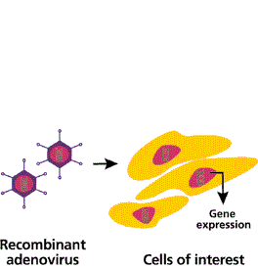
Myr Akt Transfection
Myr Akt
Green Florescent Protein
PC 3 Cells

Slide 26
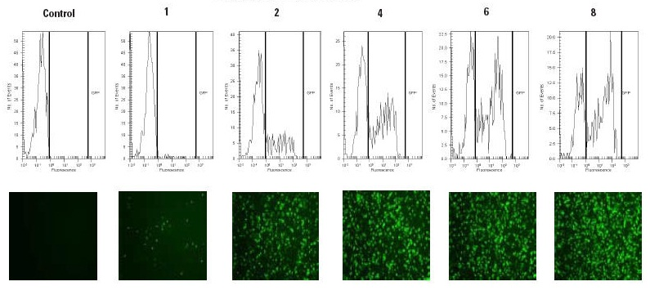
Transfection with Adenovirus
Green Fluorescent Protein
Representative Image

Slide 27
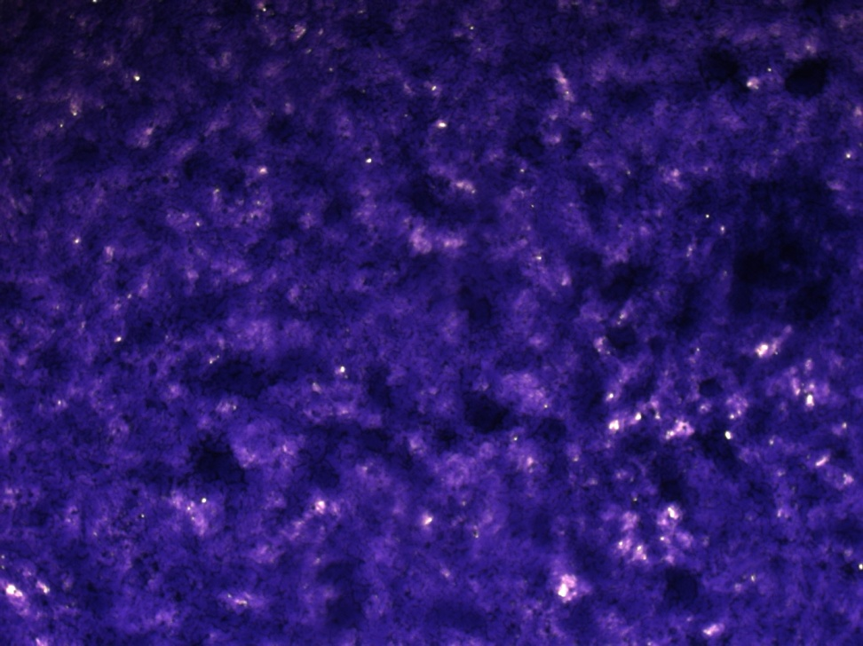
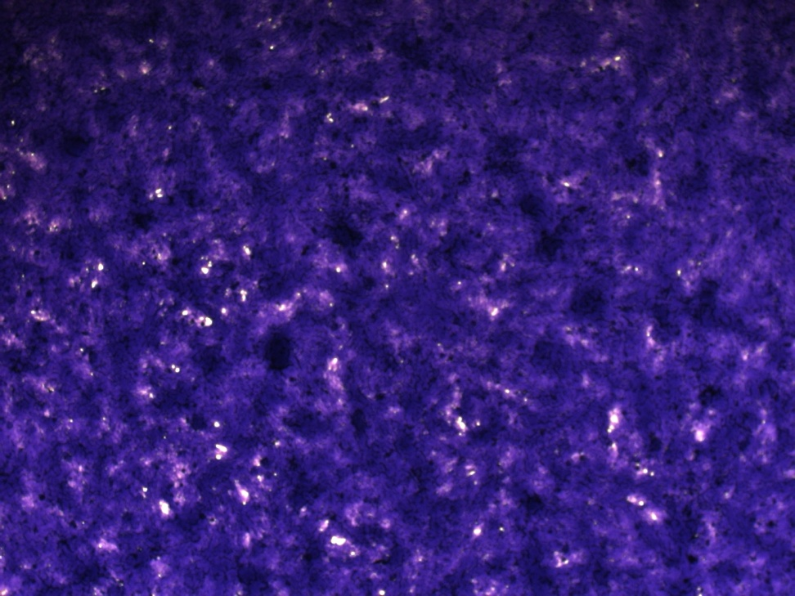
Foci Assay
Simvastatin inhibits Foci formation in PC 3 cells
Control
Simvastatin
Foci

Slide 28

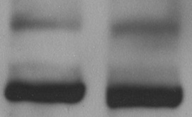

Figure 5
Simvastatin inhibits Foci formation in PC 3 cells. This effect was reversed in Myr Akt transfected cells.
A
B
C
Myr-Akt
Myr-Akt
+Simva
GFP
p < 0.04
n = 4
pAkt
pAkt
β-actin
β-actin
p < 0.03
n = 4
p = 0.43
n = 4
Number of foci (Normalized to control)
Number of foci (Normalized to control)
Number of foci (Normalized to control)

Slide 29
Simvastatin inhibited colony formation by PC3 cells is rescued by expression with constitutively active Akt (myr Akt)
A Cells were allowed to form a monolayer and were subjected to treatment with saline (control) or 25 µM simvastatin. On day 5, cells were fixed, stained and counted for colonies. Bar graph showing reduced number of colonies compared to control with simvastatin treatment.
B Bar graph showing PC3 cells stably expressing myr Akt (constitutively active) develop significantly higher number of colonies compared to cells stably expressing GFP (control).
C Bar graph showing PC3 cells stably expressing myr Akt are resistant to inhibition of colony formation by simvastatin.

Slide 30
Can this effect be reproduced In Vivo ?
Nude Mice Xenograft- Wt, Size, Growth, PSA level.
Yes
Are the same effects seen in patients ?
Work in progress
?
Prospective Clinical trial ?
Work in Progress
?

Slide 31
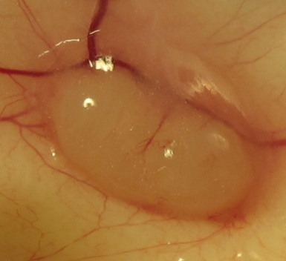
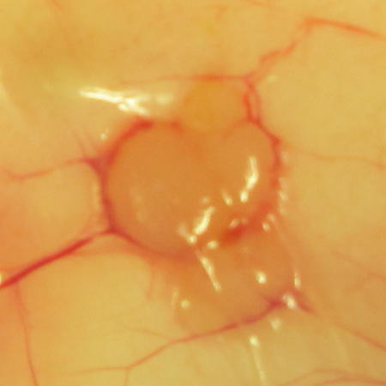
Tumor Xenograft.
SALINE
SIMVASTATIN
Simvastatin inhibits tumor growth In Vivo

Slide 32
Figure 6
Simvastatin inhibits tumor growth In Vivo
(i) 2mg/kg body weight/day
A
B
C
D
p = 0.14
n = 6
p = 0.92
n = 8
p = 0.14
n = 6
p < 0.04
n = 6
Tumor weight (g) on Day 14
Tumor Size (mm²) on Day 14
Change in tumor size (mm²)
Day7-Day11
Change in tumor size (%)
Day7-Day11
(ii) 2mg/kg body weight/12h
E
F
G
H
p < 0.02
n = 6
p < 0.02
n = 6
p < 0.03
n = 6
p < 0.02
n = 6
Tumor weight (g) on Day 14
Change in tumor size (mm²)
Day7-Day11
Change in tumor size (%)
Day7-Day11
Tumor Size (mm²) on Day 14

Slide 33






Tumor Tissue p Akt & PSA level.
B
Saline
Simva
C
Simva
Saline
p-Akt
β-Actin
β-Actin
PSA
Simvastatin inhibits tumor tissue p Akt and PSA level In Vivo

Slide 34
Simvastatin inhibits growth of PC3 tumor xenograft in nude mice
A and E: Bargraph showing the effect of simvastatin administered every 24h and 12h , respectively, on the weight of 2 week old tumor xenografts.
B and F:Bargraph showing the effect of simvastatin on the size (mm2) of 2 week old tumor xenografts.
C and G:Bargraph showing the effect of simvastatin on the changes in tumor size (mm2), compared to control (saline), between day 7 and day 11 tumor sizes.
D and H:Bargraph showing the effect of simvastatin on the percentage changes in tumor size (mm2), compared to control (saline) ,between day7 and day 11 tumors.

Slide 35
Can this effect be reproduced In Vivo ?
Nude Mice Xenograft- Wt, Size, Growth, PSA level.
Yes
Are the same effects seen in patients ?
Tissue Biopsy: Work in progress
?
Prospective Clinical trial ?
Work in Progress
?

Slide 36
Clinical Trial – Future Direction
Majority of the existing evidence relating to statins and prostate cancer is derived from post hoc analyses of clinical trials or prospective studies of statin therapy in which prostate cancer was not the primary endpoint.
Therefore, our objective is to further characterize the relationship between preoperative statin use and pathological tumor features in a cohort of men undergoing radical prostatectomy.

Slide 37
Basic Science-Future Directions (Currently underway in our Lab )
Decipher the Molecular Mechanism involved in statin induced Apoptosis and Proliferation.
Using TRAMP mice to study long term effect of statins In Vivo.

Slide 38
Translational Research
Basic
Science
Clinical Research
Translational Research

Slide 39
From Bench to Clinic
Chemo
Prevention ?
Chemo
Therapy ?
Can substrates of p Akt be used to measure tumor progression / response ?
Other Cancers ?

Slide 40
Reference
1. Hippisley-Cox J, Coupland C. Unintended effects of statins in men and women in England and Wales: population based cohort study using the QResearch database. BMJ 2010;340:c2197.
2. Mascitelli L, Pezzetta F, Goldstein MR. Why statin therapy may increase the risk for posttransplantation squamous cell carcinoma. Transpl Immunol 2010 Jun 17.
3. Goldstein MR, Mascitelli L, Pezzetta F. Might the widespread use of statin drugs explain the increase in prevalence of breast carcinoma in situ? Med Hypotheses 2010; 74(3):613-4.
4. Friedman GD, Flick ED, Udaltsova N, Chan J, Quesenberry CP, Jr., Habel LA. Erratum: Screening statins for possible carcinogenic risk: up to 9 years of follow-up of 361 859 recipients. Pharmacoepidemiol Drug Saf 2008; 17(7):751.
5. Haukka J, Sankila R, Klaukka T, et al. Incidence of cancer and statin usage--record linkage study. Int J Cancer 2010; 126(1):279-84.
6. Dale KM, Coleman CI, Henyan NN, Kluger J, White CM. Statins and cancer risk: a meta-analysis. JAMA 2006; 295(1):74-80.
7. Breau RH, Karnes RJ, Jacobson DJ, et al. The association between statin use and the diagnosis of prostate cancer in a population based cohort. J Urol 2010; 184(2):494-9.
8. Bil J, Zapala L, Nowis D, Jakobisiak M, Golab J. Statins potentiate cytostatic/cytotoxic activity of sorafenib but not sunitinib against tumor cell lines in vitro. Cancer Lett 2010; 288(1):57-67.
9. Jakobisiak M, Golab J. Statins can modulate effectiveness of antitumor therapeutic modalities. Med Res Rev 2010; 30(1):102-35.
10. Elewa HF, El-Remessy AB, Somanath PR, Fagan SC. Diverse effects of statins on angiogenesis: new therapeutic avenues. Pharmacotherapy 2010; 30(2):169-76.

Slide 41
Reference….
11. Murtola TJ, Visakorpi T, Lahtela J, Syvala H, Tammela T. Statins and prostate cancer prevention: where we are now, and future directions. Nat Clin Pract Urol 2008; 5(7):376-87.
12. Murtola TJ, Tammela TL, Lahtela J, Auvinen A. Cholesterol-lowering drugs and prostate cancer risk: a population-based case-control study. Cancer Epidemiol Biomarkers Prev 2007; 16(11):2226-32.
13. Takeda I, Maruya S, Shirasaki T, et al. Simvastatin inactivates beta1-integrin and extracellular signal-related kinase signaling and inhibits cell proliferation in head and neck squamous cell carcinoma cells. Cancer Sci 2007; 98(6):890-9.
14. Sivaprasad U, Abbas T, Dutta A. Differential efficacy of 3-hydroxy-3-methylglutaryl CoA reductase inhibitors on the cell cycle of prostate cancer cells. Mol Cancer Ther 2006; 5(9):2310-6.
15. Khanzada UK, Pardo OE, Meier C, Downward J, Seckl MJ, Arcaro A. Potent inhibition of small-cell lung cancer cell growth by simvastatin reveals selective functions of Ras isoforms in growth factor signalling. Oncogene 2006; 25(6):877-87.
16. Muck AO, Seeger H, Wallwiener D. Inhibitory effect of statins on the proliferation of human breast cancer cells. Int J Clin Pharmacol Ther 2004; 42(12):695-700.
17. Ukomadu C, Dutta A. p21-dependent inhibition of colon cancer cell growth by mevastatin is independent of inhibition of G1 cyclin-dependent kinases. J Biol Chem 2003; 278(44):43586-94.
18. Gbelcova H, Lenicek M, Zelenka J, et al. Differences in antitumor effects of various statins on human pancreatic cancer. Int J Cancer 2008; 122(6):1214-21.
19. Glynn SA, O'Sullivan D, Eustace AJ, Clynes M, O'Donovan N. The 3-hydroxy-3-methylglutaryl-coenzyme A reductase inhibitors, simvastatin, lovastatin and mevastatin inhibit proliferation and invasion of melanoma cells. BMC Cancer 2008;8:9.
20. Woodard J, Sassano A, Hay N, Platanias LC. Statin-dependent suppression of the Akt/mammalian target of rapamycin signaling cascade and programmed cell death 4 up-regulation in renal cell carcinoma. Clin Cancer Res 2008; 14(14):4640-9.
21. Kamat AM, Nelkin GM. Atorvastatin: a potential chemopreventive agent in bladder cancer. Urology 2005; 66(6):1209-12.

Slide 42
Team
Dr Shenoy’s Lab
Dr Teresa Coleman
Dr Martha Terris
Ms Mary Ann Parks , RN
Dr Judith Giri
Dr Somnath Shenoy
Thomas Kochuparambil
Belal Al-Husein
Anna Goc
Mrunal Choudhary
Junxiu Liu
Sahar Sulaiman
Ahmed Alhusban
Diana Houng
Rahul

Slide 43
Thank You ! Questions ?

