Slide 1
Fever of Unknown Origin
Medical College of Georgia, Dept. of Medicine
March 29, 2011
Interns: Lindsey Goldberg and Keerthi Rallapatti
Resident: Jamie Edwards

Slide 2
History of Present Illness:
42 y/o AAM presents as a transfer from Dublin VA with a chief complaint of FUO with a PMH significant for Multiple Sclerosis. He denies any cough, SOB, HA, CP, abdominal pain, diarrhea, dysuria, or any pain in general. He thinks he was transferred for a “spinal tap.”
Hospital course at Dublin VA:
  Early February treated with IV Ciprofloxacin and Imipenem x1 week for UTI, then discharged home on PO Ciprofloxacin for Pseudomonas in urine sensitive to all abx tested and Augmentin for concerns of aspiration, although pt passed swallow study prior to discharge
  Readmitted 2 days later on 02/10/11 with fever, AMS and started on IV Ceftriaxone/Moxi, then on 02/16/11 changed to IV Vanc/Zosyn/Fluconazole/Cipro. He continued to spike intermittent fevers, but all cultures negative thus far.
  Then, repeat culture from 02/15/11 showed 1 out of 2 blood cultures positive for gram negative and gram positive organisms.
  “Phone a Friend”…The ID Fellow at MCG was called and recommended to discontinue all IV antibiotics, and redraw new cultures. These were negative, and pt again spiked temperature, so they started him on IV Vanc/Zosyn/Cipro again 02/22/11. He was then transferred to VAMC DD for further work-up.

Slide 3
Continued History…
Past Medical History:
Past Surgical History:
Multiple Sclerosis
Neurogenic bladder
  no indwelling catheter
Seizure disorder
DMII
Decubitus ulcer, Stage I (Sacral)
Craniotomy x2 at MCG

Slide 4
More History…
Social History
Family History
Quit smoking tobacco in 1999 but did smoke ¼ ppd.
Quit EtOH in 1999, denies current use.
Denies illicit/IVDU.
Married, lives at home with wife and 1 child.
Home Health services
Army Service 1991-1995.
HTN
Cancer
Seizure disorder

Slide 5
Allergies:
Medications:
Codeine
Keppra 500mg BID
Lisinopril 2.5mg Qdaily
Omeprazole 20mg QPM
Primidone 200mg TID
Baclofen 20mg QID
Gabapentin 300mg TID
Interferon Beta-1A 44mcg/0.5ml SQ M/W/F

Slide 6
Physical Examination:
Vital Signs: T: 36.7, HR: 108, BP: 142/73, RR: 20, Pox: 97% on RA
Physical Exam:
  Gen: NAD, A&Ox3, multiple tremors and spasticity while talking
  HEENT: NC/AT, exotropia, no icterus
  CV: regular rhythm, S1/S2, no murmurs/rubs/gallops, no JVD
  Pulm: CTA-b/l, no w/r/r, non-labored
  Ext: no c/c/e, prevalon boots in place bilaterally, +spasticity and tremors especially of right arm, +peripheral IV at Right shoulder
  Neuro: A&Ox3, speech slowed and difficult, +spasticity, +tremors, able to squeeze left hand slightly
  Skin: Stage II sacral decubitus ulcer with pink granulation tissue, no discharge

Slide 7
Admission Labs and Imaging:
WBC: 9.3, Hgb: 10.2, Hct: 30.7, Plt: 375
Na: 137, K: 3.9, Cl: 99.4, CO2: 25, BUN: 5, Cr: 0.6, Gluc: 93, Ca: 8.5, Mg: 1.9, Ph: 3.2, T prot: 7.1, Alb: 3.1, AST: 38, ALT:58, ALP: 59, T bili: 0.1
Coags: INR 1.70
Vanc Trough 15.7
UA negative
EKG showed NSR
Chest X-ray showed no pleural effusions, no signs of consolidation or infiltrate

Slide 8

Differential…?

Slide 9
Based on the Differential…What Next?

Slide 10
Labs:
Infectious work-up:
  Blood cultures and urine culture: No growth
  HIV negative
  Hep A, Hep B, and Hep C nonreactive/negative
  RPR nonreactive
  Malaria smear negative (no malarial forms)
  PPD negative
  EBV results indicated past infection, not current infection
  CMV negative (<200)
  Serum Cryptococcus negative
  CRP elevated at 46.1
Non-infectious Inflammatory diseases (NIID)
  Rheumatologic work-up:
    ANA negative
    RF within normal limits (3.1)
    Anti-CCP negative (<8)
    CPK within normal limits (56)
    ESR within normal limits at 5
    CRP elevated at 46.1
  Endocrine:
    TSH and T4 within normal limits
Malignancy:
  Hemoccult stool negative
  PSA not elevated
Drug-induced fever:
  Discontinued all antibiotics on admission
  Did not restart Interferon

Slide 11
Fever of Unknown Origin:
Historically term first used in 1961
  By R.B. Petersdorf
Definition:
  Temp >38.3 on several occasions
  Duration of >3 weeks
  Diagnosis that remains uncertain after 1 week of investigation
    Durack and Street suggested change in criteria in 1991 to an uncertain diagnosis after 3 outpatient visits or 3 inpatient days

Slide 12
Fever of Unknown Origin
Classical vs. Non-classical FUO populations
    Spectrum of underlying disease differs from Classical FUO with more infectious, neoplastic, and drug-induced cases
    Prompt empirical antimicrobial therapy +/- antifungal and antiviral therapy, esp. in Neutropenic FUO
      Contrasts to typically using caution against empirical therapy in Classical FUO
  Classical FUO:
    Fever ≥ 38.3 on several occasions
    Duration ≥ 3 weeks
    Diagnosis uncertain after 3 days of inpatient investigation or 3 outpatient visits
  Non-classical includes
    Nosocomial FUO
      Fever ≥ 38.3 on several occasions and Duration ≥ 3 weeks
      Hospitalized patients with infection not present or incubating on admission
      Diagnosis uncertain after 3 days despite appropriate investigations, including at least 48H incubation of microbiological culture
    HIV-associated FUO
    Neutropenic FUO
FUO: over 200 reported cases in literature
  Four diagnostic categories:
    Infections
    Non-infectious inflammatory diseases
    Malignancy
    Miscellaneous

Slide 13
Minimal Diagnostic Work-up
History**
Physical examination
CBC and differential
Blood film reviewed by hematopathologist
CMP, LDH, bilirubin
UA and microscopy
Blood cultures and urine cultures
  Joints, pleura, ascites, or CSF if clinically indicated
ANA and RF
HIV
Hepatitis serology
CMV IgM Abs, heterophil antibody test
Q-fever serology (if exposure risk factors exist)
Chest X-ray

Slide 14
Further testing:
Evidence Recommends:
Evidence Recommends Against the following:
Duke Criteria: Infective endocarditis (1-5% of FUO cases)
Liver Biopsy: benefits outweigh risks
Temporal Artery Biopsy:
  Two studies identified Temporal Arteritis 16% and 17%
  Especially elderly patients
CT abdomen has high diagnostic yield
  Intra-abdominal abscesses
  Lymphoproliferative disorders
Nuclear Imaging
  Technetium is tracer of choice
Bone Marrow cultures in immunocompetent patients
Diagnostic yield 0-2%

Slide 15
Spectrum of diseases:
“No diagnosis” 19%
Infection 28%
Inflammatory diseases 21%
Malignancies 17%
Temporal Arteritis in the elderly 16-17%
DVT 3%

Slide 16
Distribution of disease categories:
Between 1961 and 1990: of 692 cases
    34% infection
    22.1% malignancy
    12.5% non-infectious inflammatory diseases (NIID)
    15% miscellaneous
    15% undiagnosed
From 1990 till present:
    Frequency of infections and malignancy decreased
    NIID and undiagnosed cases increased

Slide 17
Final Answer?
Never forget a good history!
Patient has history of recurrent DVTs and is on Coumadin
Subtherapeutic INR on admission
Started Heparin drip
On Monday Lower Extremity Dopplers showed “Acute, completely occlusive deep venous thrombosis of thebilateral lower extremities; involving the superficial femoral vein on the right, and the common femoral, superficial femoral, profunda femoral, greater saphenous veins on the left. Also, chronic, wall associated subtotal deep venous thrombosis within the distal left superficial femoral and popliteal veins.”
DVT as cause of FUO:
  Venous thrombosis can present with prolonged fever
  3 series reported DVT as the cause of FUO in 2% to 6% of cases

Slide 18
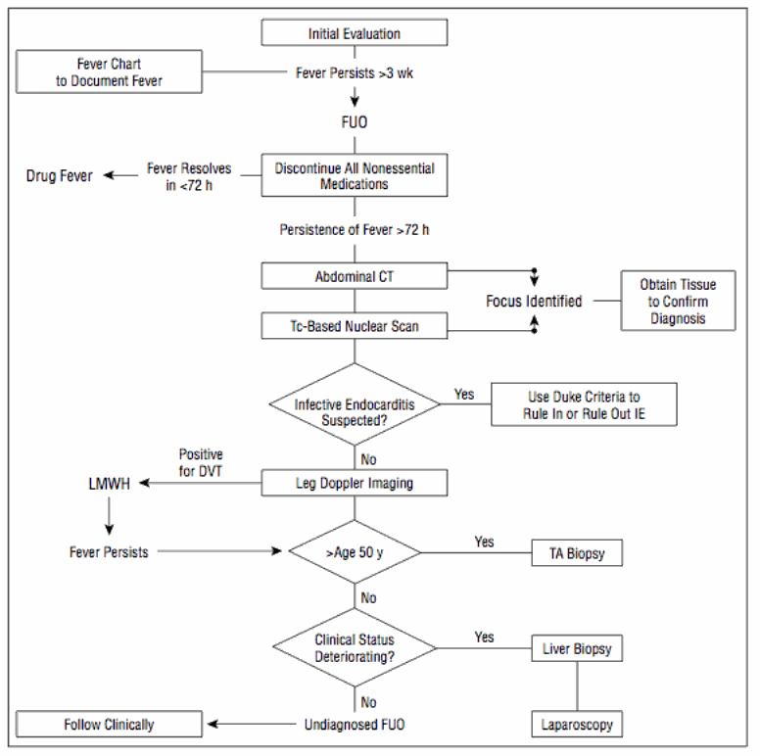

Slide 19
References
Knockaert DC, Vanderschueren S, Blockmans D. Fever of unknown origin in adults: 40 years on. J Intern Med. 2003;253:263-275.
Mourad O, Palda V, Detsky AS. A comprehensive evidence-based approach to fever of unknown origin. Arch Intern Med. 2003;163:545-551
Zenone, T. Fever of unknown origin in adults: evaluation of 144 cases in a non-university hospital. Scand J Infect Dis 2006; 38:632.
Knockaert, DC, Dujardin, KS, Bobbaers, HJ. Long-term follow-up of patients with undiagnosed fever of unknown origin. Arch Intern Med 1996; 156:618.
Mackowiak, PA, LeMaistre, CF. Drug fever: a critical appraisal of conventional concepts. An analysis of 51 episodes in two Dallas hospitals and 97 episodes reported in the English literature. Ann Intern Med 1987; 106:728.
Bleeker-Rovers, CP, Vos, FJ, de Kleijn, EM, et al. A prospective multicenter study on fever of unknown origin: the yield of a structured diagnostic protocol. Medicine (Baltimore) 2007; 86:26.

