Slide 1
Common Variable Immunodeficiency
Thomas Kochuparambil
10/29/10

Slide 2
Pathophysiology
Primary immunodeficiency diseases.
- Hypo gamma globulinemia
- Recurrent bacterial infections
Defect is a failure in B cell differentiation with impaired secretion of immunoglobulin.
The pathophysiology is poorly understood(? global immune dysfunction) and T-cell lymphocyte abnormalities described in some patients
The clinical spectrum is broad. Symptoms may not be obvious until middle or even late adult life.

Slide 3
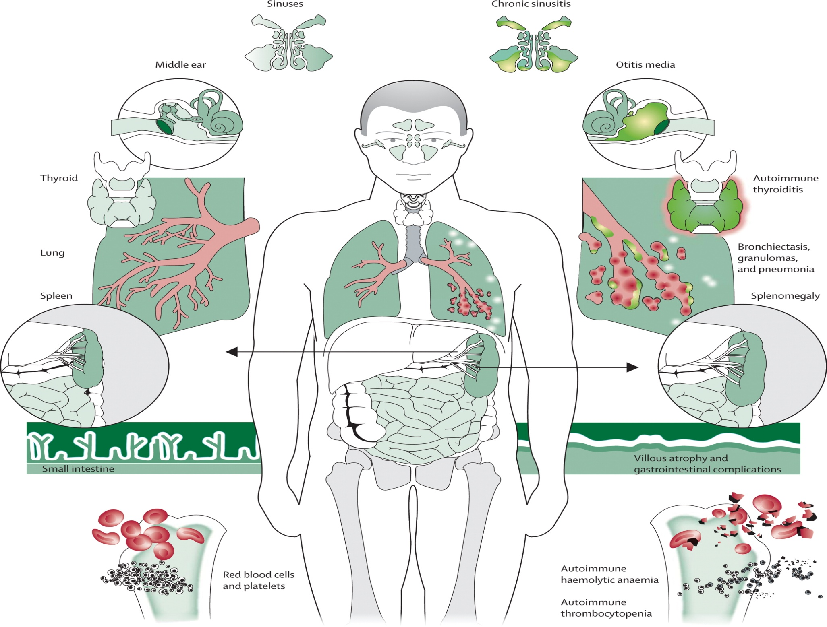
Park, M.A., et al., Common variable immunodeficiency: a new look at an old disease. The Lancet, 2008. 372(9637): p. 489-502.

Slide 4
Diagnosis of Exclusion
Persistent drop in immunoglobulin level ( < 2 SD) for 2 years since onset along with all 3 criteria's :
Minimum Criteria
Onset of immunodeficiency > 4 Y age
Dec response to vaccines
Exclude other causes of immunodeficiency
IgG and IgA : Probable Diagnosis
Ig G, M, or A : Possible Diagnosis
A.Clinical Immuno, 1999,93-190

Slide 5
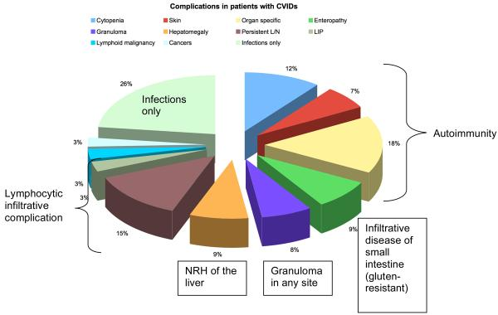
Update in understanding common variable immunodeficiency disorders (CVIDs) and the management of patients with these conditions. British Journal of Haematology, 2009. 145(6): p. 709-727.

Slide 6
Treatment
Basic treatment : replacement immunoglobulin in adequate doses.
The aim of therapy is reduction of infections and prevention of life-threatening infections.
Individual patients require variable doses to prevent infections and IgG trough levels is not reliable.
Subcutaneous (SCIg) self administration convenient for patients . (Vivaglobulin™ )
PROBLEM: Many of these patients have profound IgA deficiency. Beware of anaphylactic reactions. Use Ig with low IgA levels. (Gammagard™ )

Slide 7
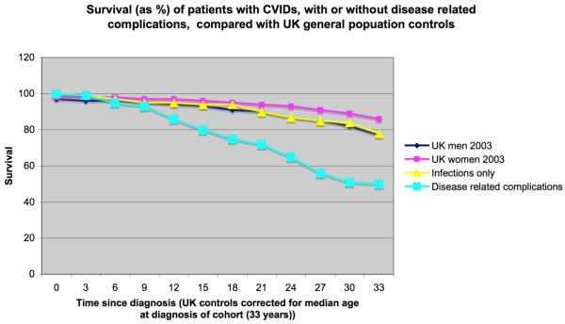
Update in understanding common variable immunodeficiency disorders (CVIDs) and the management of patients with these conditions. British Journal of Haematology, 2009. 145(6): p. 709-727.

Slide 8
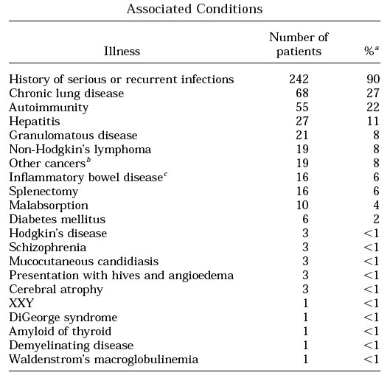
*
*
*
*
*
A.Clinical Immuno, 1999,93-190

Slide 9
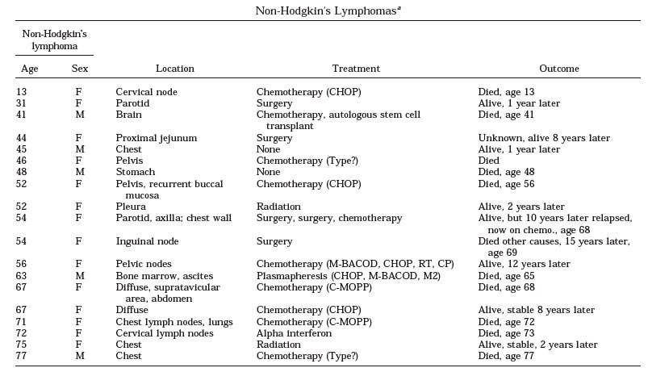
A.Clinical Immuno, 1999,93-190

Slide 10
NHL
~ 8 % develop NHL
Age of onset 60-70’s
Location variable
EBV negative
Histology indistinguishable from 1⁰ NHL
Management is same as 1⁰ NHL
Update in understanding common variable immunodeficiency disorders (CVIDs) and the management of patients with these conditions. British Journal of Haematology, 2009. 145(6): p. 709-727.

Slide 11
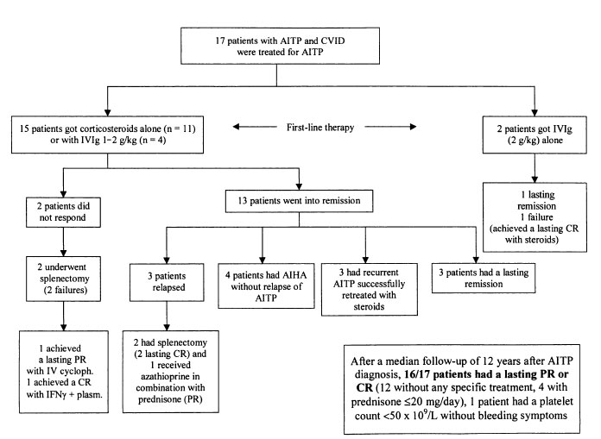
AITP/AIHA
A.Clinical Immuno, 1999,93-190

Slide 12
AITP/AIHA
AITP / AIHA (or Evans Syndrome) is frequent in patients with CVID (~ 12%) and is not prevented by IVIg therapy
Steroids and splenectomy seem to be effective therapy for these patients but with increased risk of severe infections.
Case report’s : Rituximab effective in refractory cases
Update in understanding common variable immunodeficiency disorders (CVIDs) and the management of patients with these conditions. British Journal of Haematology, 2009. 145(6): p. 709-727.

Slide 13
Thank you !

