Slide 1
Personal Experience in Research ACP Conference 2010
Thomas Kochuparambil

Slide 2
Why Research Excites Me !
Stepping into a new area
Joy of discovery
Eureka moments
Success/ Disappointment
Lessons from Failures
Respect for the disease
Better understanding of disease
Benjamin Franklin

Slide 3
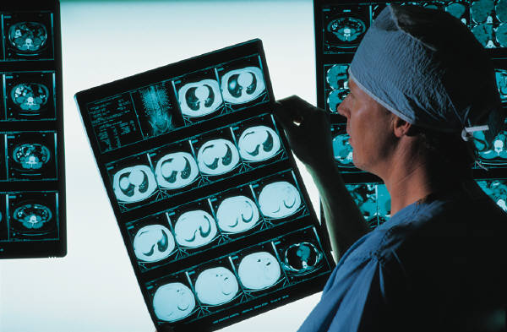
Clinical Vs Basic Science
Clinical:
Shorter duration
No additional skills required
Basic Science:
Joy of learning
Suspense / Excitement
Translational
Best of both

Slide 4
Off the beaten path..
Taking the first step.
Anxiety / Excitement of conceiving a project from scratch.

Slide 5
“I don't look to jump over 7-foot bars: I look around for 1-foot bars that I can step over.”
Warren Buffett

Slide 6
Feasibility of the Project
Skill Level
Time frame/effort
Productive project
Economic feasibility

Slide 7
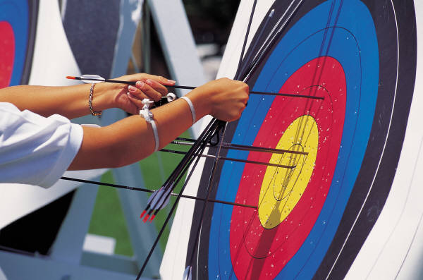
“Have a bias toward action - let's see something happen now. You can break that big plan into small steps and take the first step right away.”
Indira Gandhi

Slide 8
Planning and Time Management
Set short term goals as well as long term goals
Set reasonable timeframe for each goal
Have a back up plan
Learn / Upgrade your skills
Time management is key

Slide 9
“I have not failed. I've just found 10,000 way that won't work.” Thomas Alva Edison

Slide 10
Up’s and Down’s
Joy of discovery.
Lessons from failure.

Slide 11
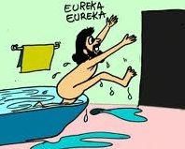
Eureka Moments
Getting Up at 3 am with a novel idea..Eureka… PubMed : published 2 weeks ago……
Most breakthroughs happen at unexpected time, most commonly after a series of failure.

Slide 12
“The most important single ingredient in the formula of success is knowing how to get along with people.”
Theodore Roosevelt

Slide 13
Team Work
Vital component of success of your project
Respect you colleagues
Call days ,night, weekends ..
Integration of basic science with clinical knowledge.

Slide 14
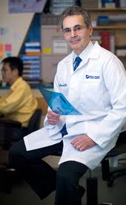
High Point !
Young Investigator Mentoring Lunch AACR 2010:
Dr Ronald DePinho ,MD.
Dana Faber/Harvard
Chairman of Human Genome Project
Entrepreneur (biotech)
Represented US in Taekwondo
Two Characters of Successful People
Speed at which a person walks
Sense of urgency in whatever you do

Slide 15
Fruits of Labor
Publications
Posters , Oral presentation, Peer reviewed journals
Awards and Honors
Grants
Ultimate reward
“Joy of discovery”
“Sense of accomplishment”

Slide 16
Acknowledgement
Mentors
Dr Madaio
Dr Awan
Dr Kutlar
Dr Ustun
Dr Jillela
Dr Samuel
Dr Shenoy
Dr Coleman
Dr Terris
Dr Lee
Dr Sreekumar
Lab Colleagues
Belal Al-Husein
Anna Goc
Mrunal Choudhary
Junxiu Liu
Sahar Soliman
Ahmed Al Husban
Diana Houng
Ahamed I
Maha Abdalla
Rahul D

