Slide 1

Georgia Statewide AHEC Network

Slide 2
Georgia Statewide AHEC Network
A partnership coordinated by the Georgia Regents University, the Georgia Statewide AHEC Network is a complex, multi-disciplinary effort which responds to the problems of health professionals supply and distribution in rural and underserved areas of the state.
The goal of the AHEC program is to improve access to quality, primary health care in medically underserved areas through educational activities designed to recruit, train, and retain community-based health care personnel where they are most needed. The system links communities, particularly rural, remote and underserved areas, with academic institutions to increase access to educational programs for health care professionals throughout the state.
Notes:
The AHEC is a health workforce program. We work with all health professional programs in the state of Georgia interested in placing students in community based education rotations particularly in rural and/or medically underserved areas of the state. Our goal is for students to have quality educational experiences in Georgia communities in hopes you will make a connection and the desire to return to one of those communities as a practicing physician.

Slide 3
Georgia Statewide AHEC Network
Mission: To support the recruitment, education, training and retention of a diverse health professions workforce throughout Georgia.
Health Professions Workforce Pipeline
  RECRUIT → TRAIN → RETAIN
Network Program Goals:
RECRUIT: to educate community members about health career choices and recruit future health professionals.
TRAIN: To facilitate community based clinical training experiences for students and residents.
RETAIN: To provide education resources to assist and support health care professionals.

Slide 4
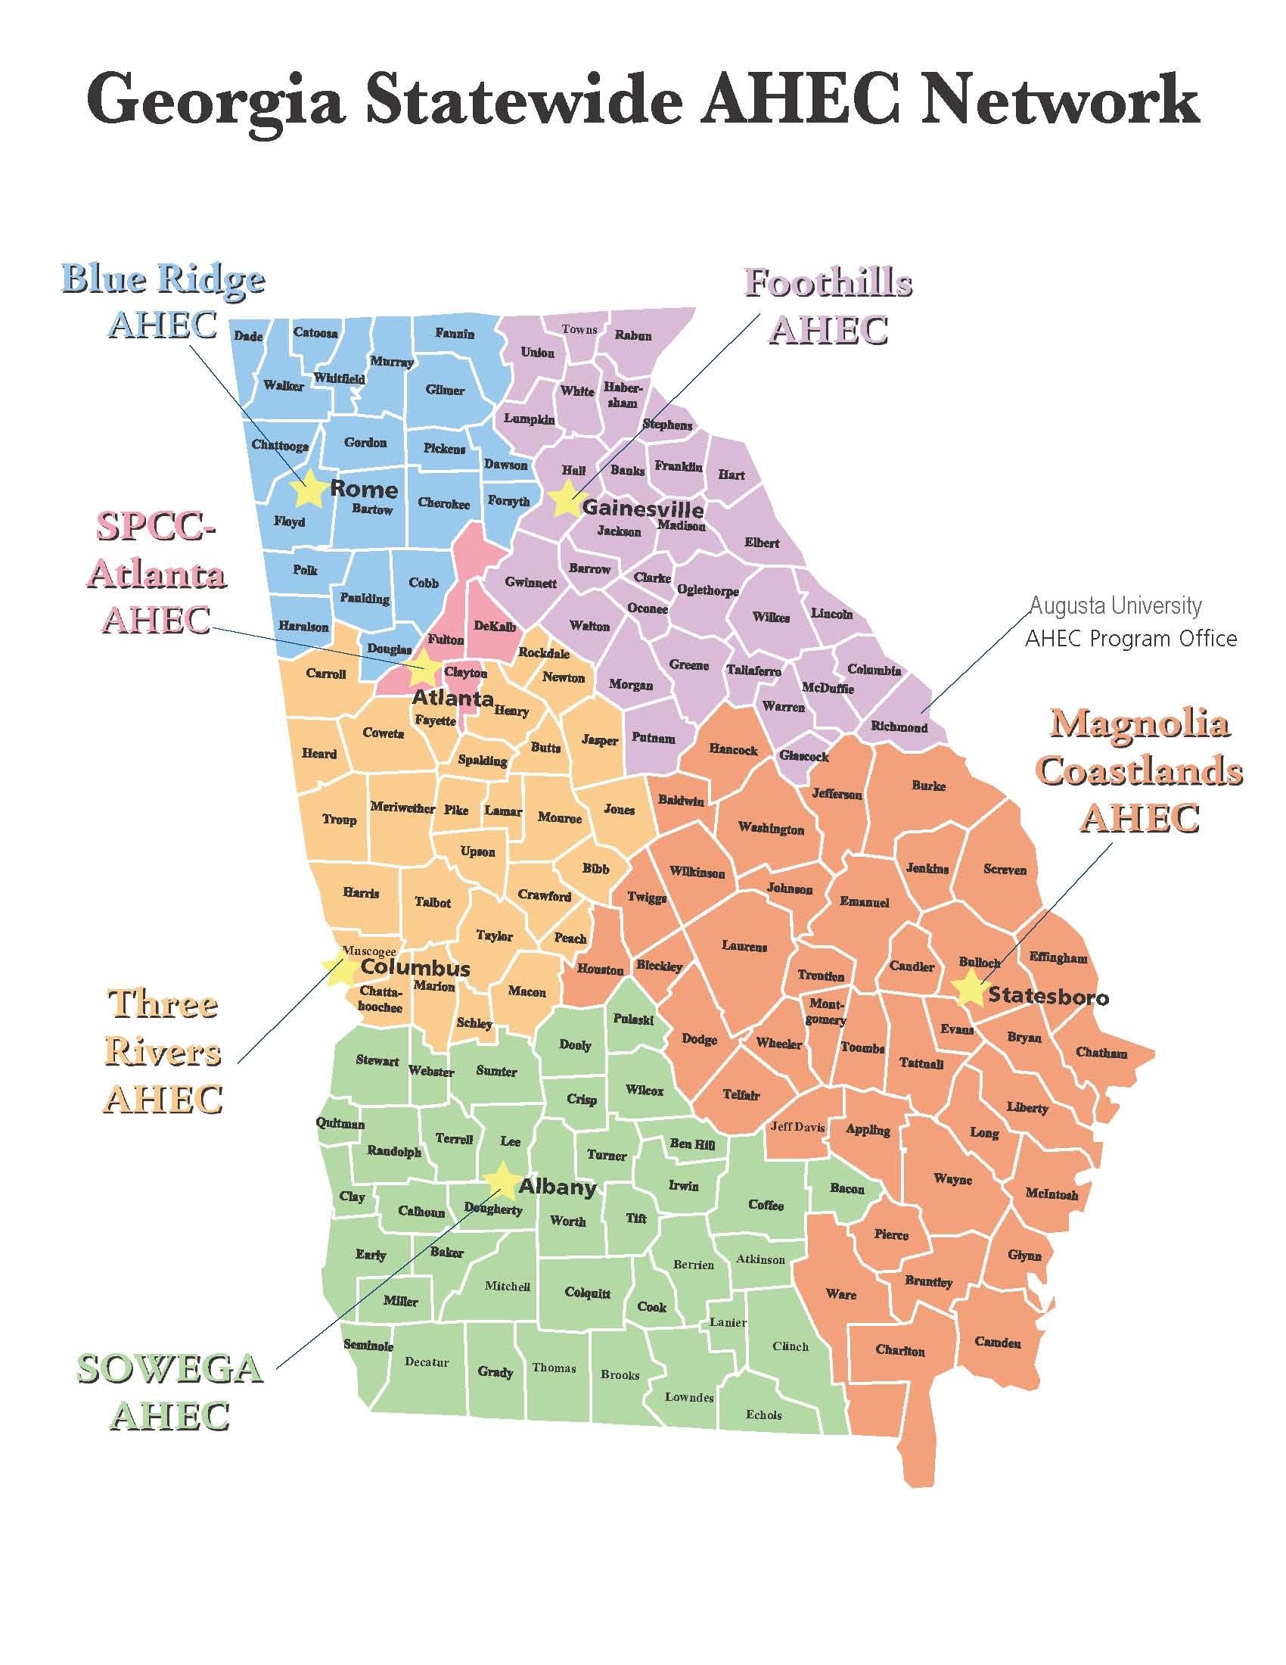

Slide 5

Georgia AHEC Centers
Each AHEC Center is a community-driven, non-profit corporation supported by federal and local assistance. Each AHEC in Georgia will look a little different based on individual funding opportunities as well as needs of the communities they serve in their particular region.
Notes:
I mention this because housing from AHEC region to AHEC region look very different. Housing comes in many varieties in for community based rotations. Housing is not paid for by GRU, rather the regional AHEC supplies the dollars or they will have community organizations partner to provide housing or some housing is provided 100% by physicians, hospitals, etc.

Slide 6
Health Professions Student Support:
Each AHEC office staffs a preceptor coordinator that works to develop partnerships with community based health care practitioners to provide necessary clinical training sites for various health professional students from Georgia and other states.

Slide 7
AHEC Preceptor Coordinators
Blue Ridge AHEC – Mandy Hunter
Foothills AHEC – Holly Stewart
Magnolia Coastlands AHEC – Bela Kundu
SOWEGA AHEC – Rashae Oliver
SPCC Atlanta AHEC – Kedrick Williams
Three Rivers AHEC – Crystal Hand
Notes:
The Atlanta AHEC does not have housing due to the elevated costs in the metro Atlanta area but they do provide housing stipends.

Slide 8
AHEC is Here To Help You:
Housing/housing stipend
Travel stipend (if no housing provided and funding is
available)
Support while on rotation
Financial aid information
Orientation and information about local community
NOTE: AHEC funding for housing and travel stipends is based on state and federal dollars as well as community partnerships and grant opportunities. Changes to housing availability and locations can occur during the academic year based on those funding sources.

Slide 9
Things you MUST do before a community based education rotation:
Read all information about a site and follow instructions on how/when to report and what to do before the rotation
Contact local AHEC (6 weeks prior to rotation start date)
Turn in all necessary AHEC paperwork on time
Make sure all information provided to a site is up to date
Read AHEC housing agreement carefully

Slide 10
What you should know about
AHEC housing:
Sign and return AHEC housing agreement
AHEC housing is clean, safe and sufficient
You can and most likely will share a room
AHEC housing is co-ed
All housing rules are expected to be followed and will be enforced
The AHEC housing is provided to you in most cases at no cost

Slide 11
AHEC Housing Continued:
If you indicated the need for housing when you went through the lottery then housing has been reserved for you and you are expected to use it.
If you do not need housing you requested then cancel immediately.
If you fail to use your reserved AHEC housing
and do not cancel before 30 days you can be
fined $200 and forfeit future use of housing.
Read AHEC housing agreement carefully and be aware of all rules and cancellation policies.

Slide 12

Erin Mundy, MPA
AHEC Director of Community Based Training Programs
Georgia Statewide AHEC Network Program Office
Assistant Professor, Department of Family Medicine
Medical College of Georgia at Augusta University
emundy@augusta.edu
Phone 678-232-3759

