Slide 1

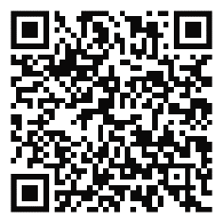
Pre-Medical
Virtual Summit
MCG Office of Learner Diversity, Equity, and Inclusion of the MCG Office of Academic Affairs, and Student National Medical Association
Friday, February 11, 2022 from 2:00 -5:00pm EDT

Slide 2

2022 Pre–Medical Summit Program Outline Friday, February 11, 2022, 2:00- 5:00 pm EDT via Zoom
Welcome and Overview
Why MCG/Why Augusta
Breakout Session 1 High School Track-How to Prepare for Medical School College/Graduate Track—MCAT and AMCAS Application
10-minute Break
MCG Admissions Process
Breakout Session 2 High School Track—Summer Enrichment Programs (SHPEP and SEEP) College/Graduate Track—Contingency Planning: Preparing for the What If I Don’t Get into Medical School on the First Try?
10-minute Break
SNMA Student Panel
Closing Remarks

Slide 3
