Slide 1
Psychiatry Grand Rounds February 27, 2014 Presented by: Medical College of Georgia Department of Psychiatry and Health Behavior and Division of Continuing Education

Slide 2
Disclosure
Drs. Rosenkoetter and Smith report no actual or potential conflicts of interest in relation to this program or presentation.

Slide 3
Using Mobile, Video Analysis Technology to Record and Evaluate Student Interviews: A Pilot Study
Marlene M Rosenkoetter, PhD, RN, CNS, FAAN
Professor, Department of Biobehavioral Nursing
Deborah Smith, DNP, RN
Associate Professor, Department of Physiological & Technical Nursing
College of Nursing
Georgia Regents University
Augusta, GA, USA
Funded by HRSA #D11HP22191
M Rosenkoetter, Project Director

Slide 4
Acknowledgements Faculty Team Members
Max Stachura, MD (Georgia Regents University)
Julia Ball, PhD, RN (University of South Carolina)
Rebecca Corvey, EdD, RN (Georgia Middle State College)
Darrell Thompson, DNP, RN (Georgia Middle State College)
Carol Hunter, MSN, DNP(C), RN (Georgia Regents University)
Sally Richter, MSN, RN (Columbus State University)
Gail Jones, DNP, RN (Columbus State University)
JoEllen McDonough, PhD, RN (University of South Carolina & Georgia Regents University)
Tamara McKethan, MSN, PhD(C), RN (Georgia Regents University)
Amanda Bowden, MSN, RN (Columbus State University)
Linda Morgan, MSN, RN (Macon State University)

Slide 5
Objectives
Describe the application of VideoWurks™ in teaching clinical nursing courses in community settings.
Discuss the implications of human subjects protection when videotaping student/resident interactions.
Identify the components of videotaping, uploads of assessments and evaluation of students in clinical settings.
Describe potential application of videotaping student/patient interactions in medical settings.

Slide 6
Conceptual Framework
Social System:
Roles
Relationships
Support Groups
Self-Esteem
Use of Time
Life Structure
Social System:
Roles
Relationships
Support Groups
Self-Esteem
Use of Time
Life Structure
HIPAA Compliant Server
Ethernet Connection
Video Clips
Student Self-Assessment
Faculty Assessment
Student Self-Assessment
Faculty Assessment
Student, Faculty, Resident
Evidence
Evidence
Quality Geriatric Care
Quality Geriatric Care
Home Setting
Student-Resident-Faculty
Interactions
Home Setting
Student-Resident-Faculty
Interactions
Geriatric Nursing Standards
Technical System:
Video Camera
Laptop Computer
Tripod
Geriatric Nursing Standards
Technical System:
Video Camera
Laptop Computer
Tripod
Project Evaluation
Student
Faculty
Resident
Evaluation
Student
Faculty
Resident

Slide 7
Life Patterns Model*
Roles
Relationships
Use of Time
Self-Esteem
Support Groups
Life Structure
*D Koljeski (1982), M Rosenkoetter et al. (2013, 2010, 2009, 2008, 2007, etc.)

Slide 8
How It “Wurks”!
Slides and Screenshots Used with Permission Instructive Insight, Dr. Art Recesso

Slide 9
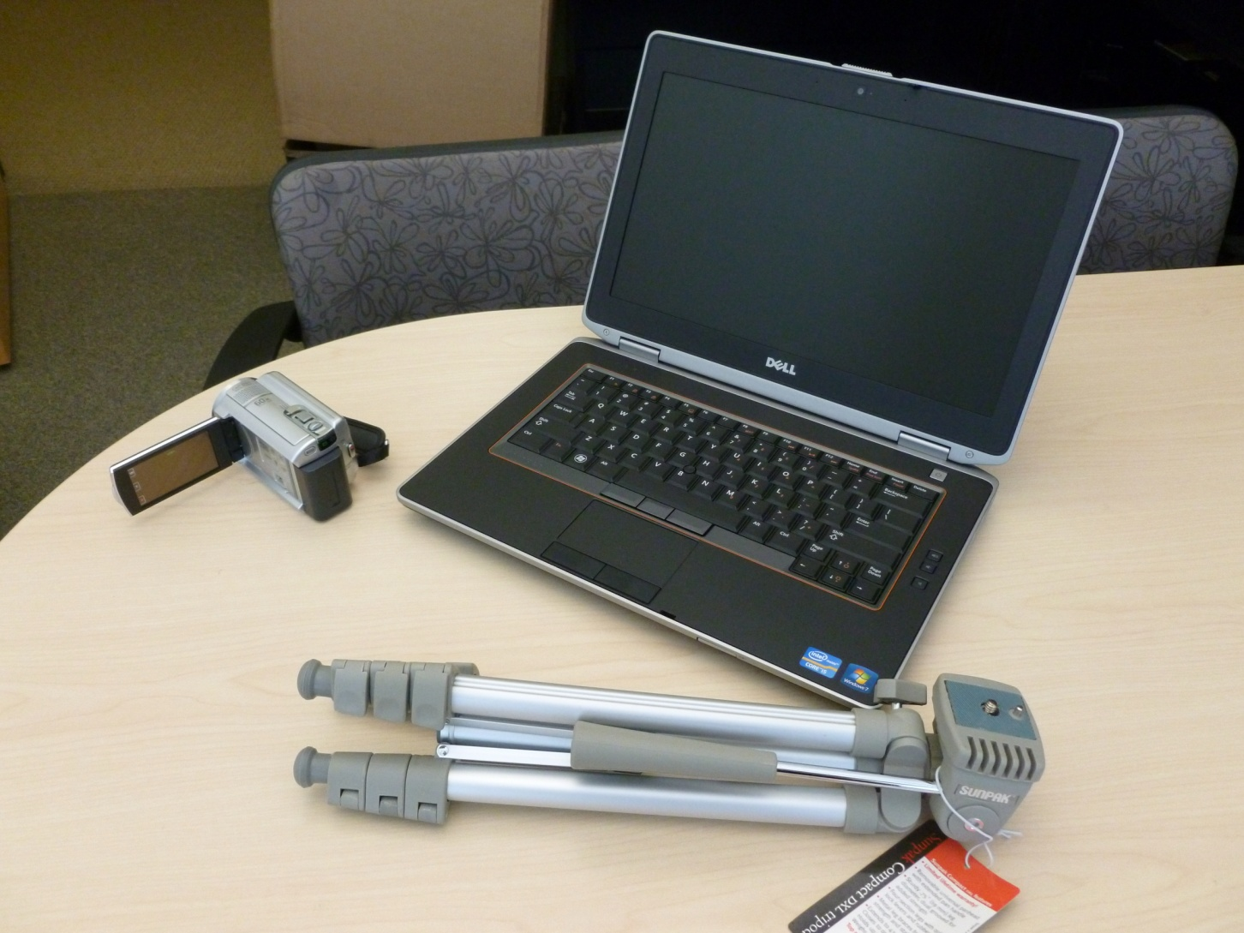
Equipment

Slide 10
The Process
Setup
Recordings
Closure

Slide 11
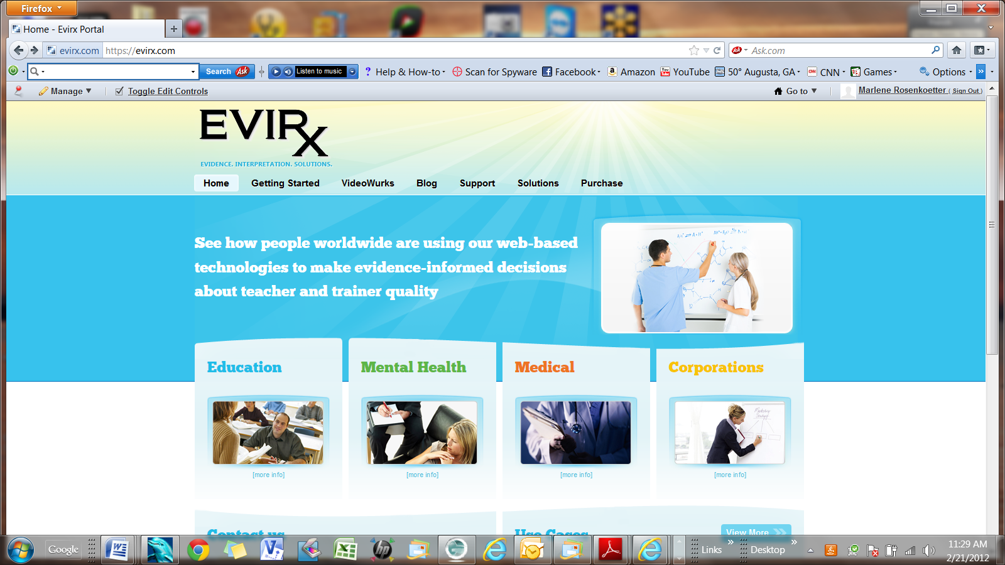

Slide 12
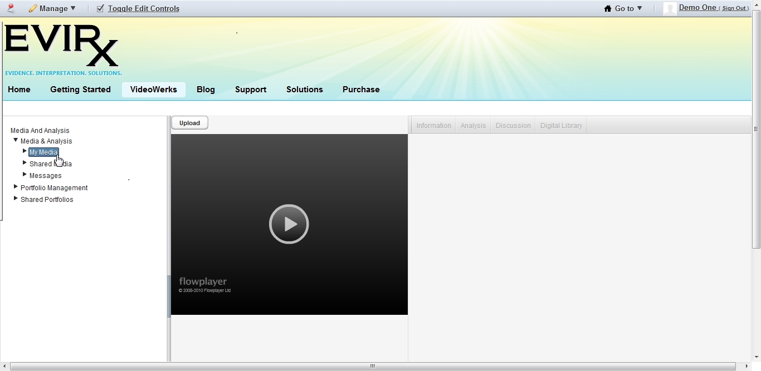

Slide 13
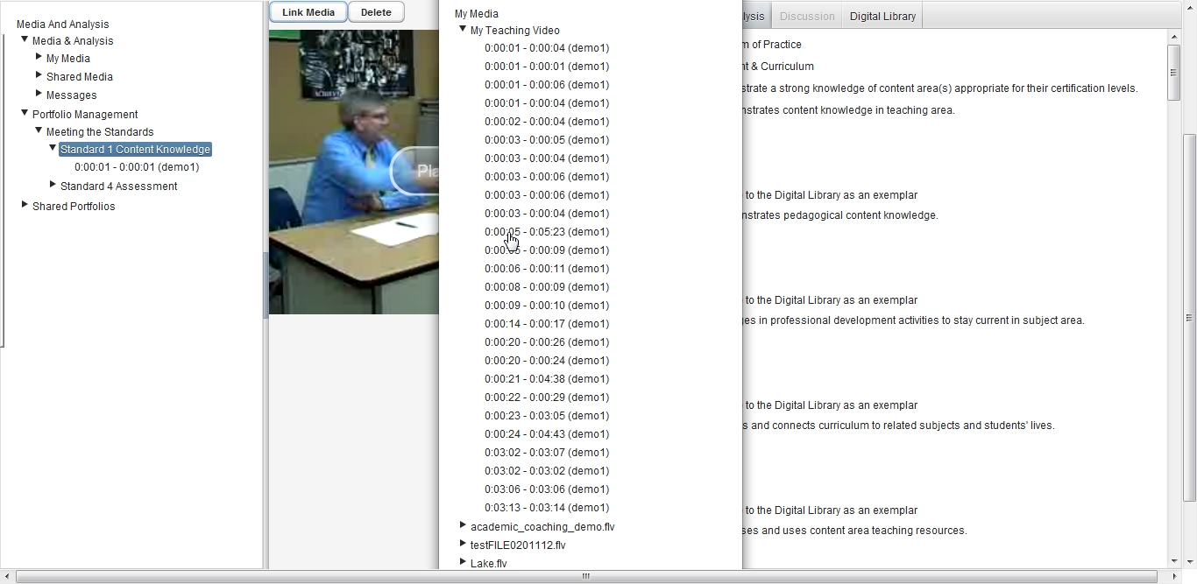

Slide 14
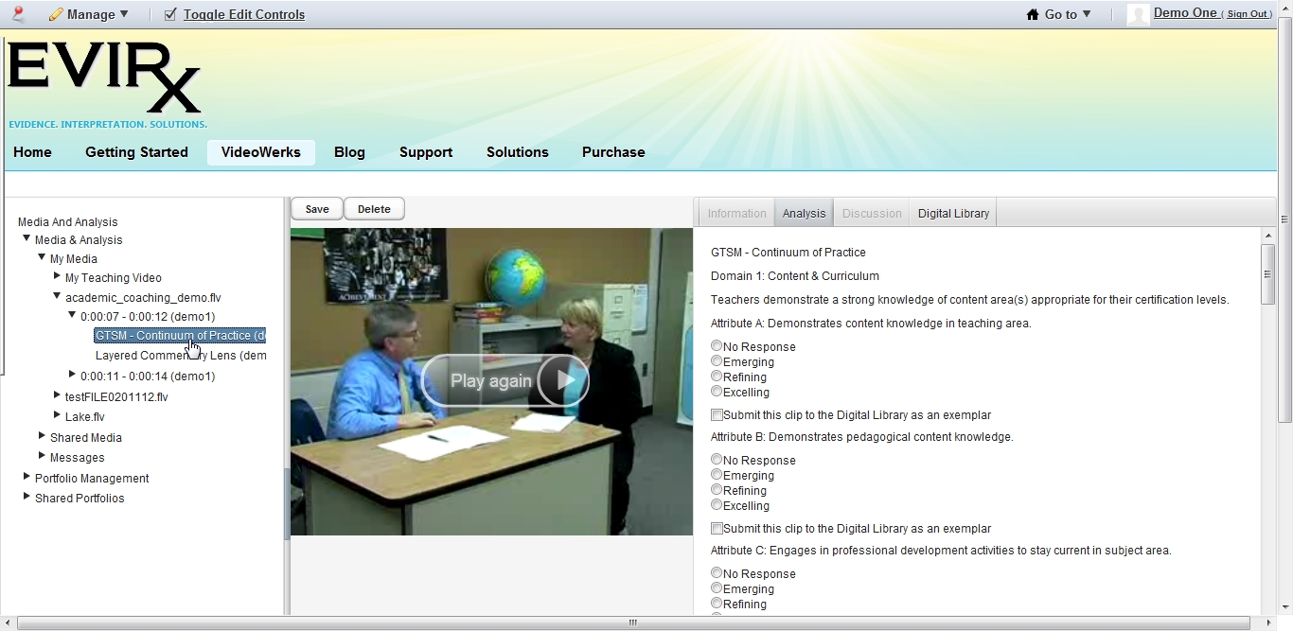

Slide 15
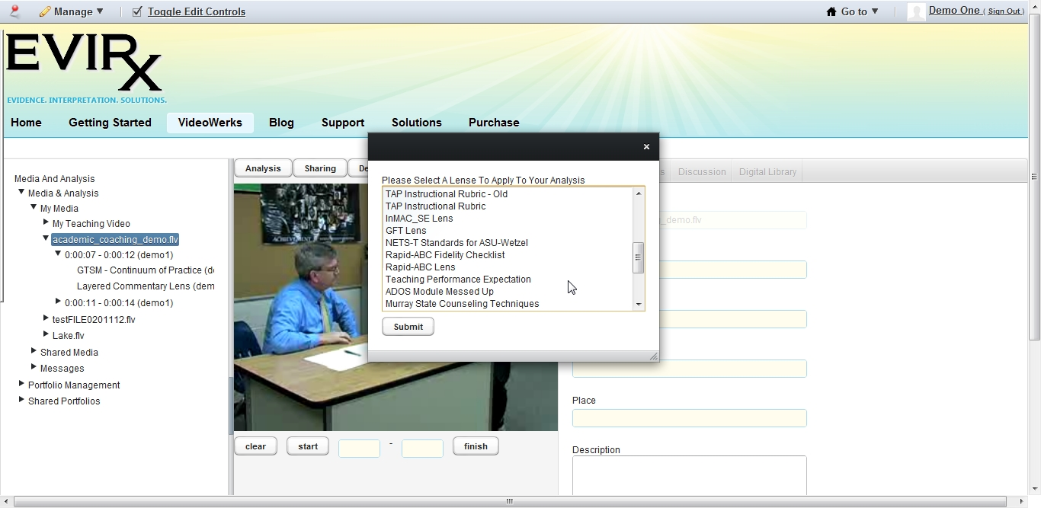

Slide 16
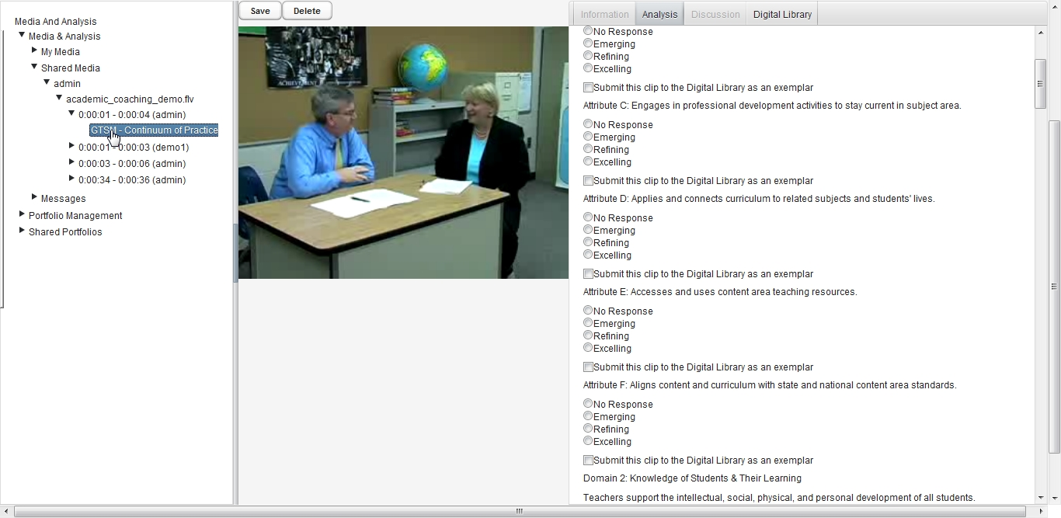

Slide 17
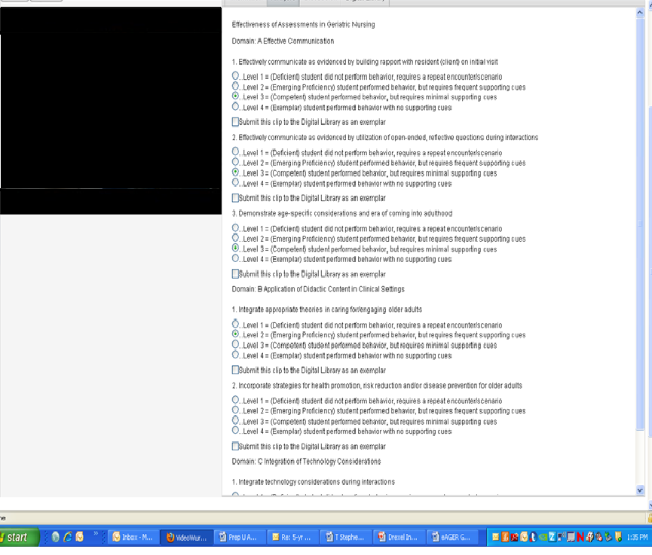
Geriatric Analysis Tool

Slide 18
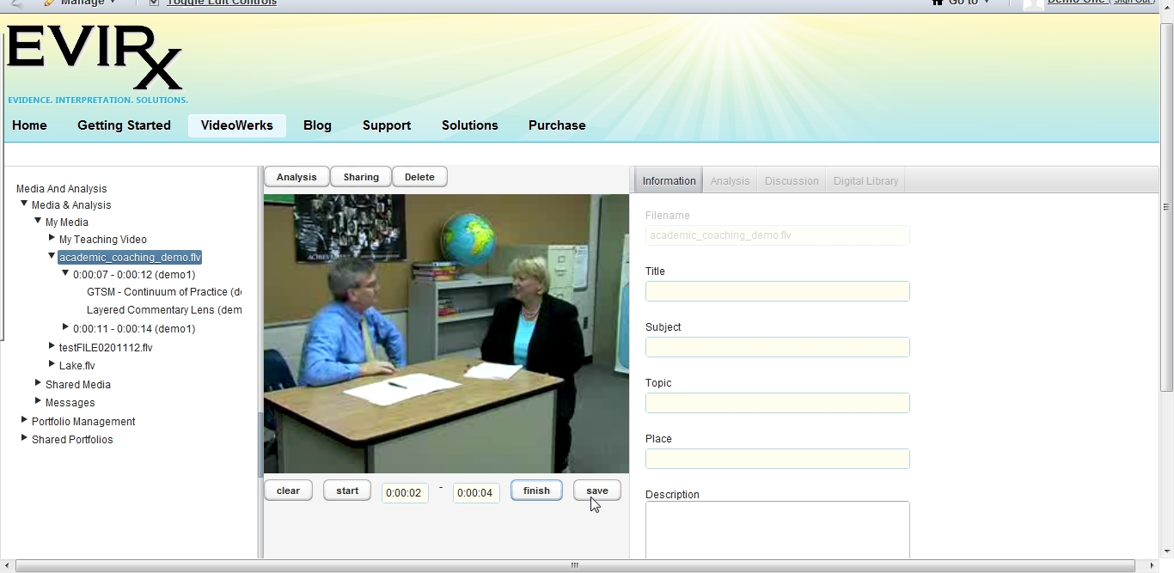

Slide 19
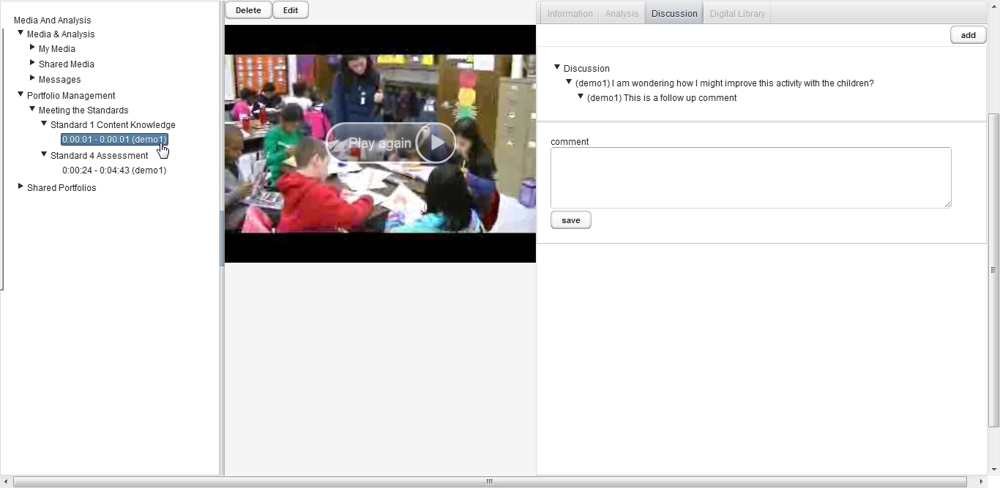

Slide 20
Online Presentation

Slide 21
Institutional Review Board Issues
Instructive Insight – Deemed a Secured Server by IRB/IT
HIPAA Compliance –Consent Letters for All 3 Surveys & Resident Participation
Use of Laptop Computers for Personally Identifiable Info.
Use of Laptops by Students for Personal Use Not Allowed
Course Requirement – Consent not Required for Students

Slide 22
Institutional Review Board Issues
Educating the IRB Staff
VAT - Course Requirement - not Optional
Students Share Videotapes - Standard Practice
(Consent not Required)

Slide 23
Institutional Review Board Issues
Evaluation of Curriculum Faculty Responsibility – Consent Still Required @ All Sites
Pre-Post Tests – Course Requirements
Written Consent of Clients for Videotaping & HIPAA Compliance Shared with Clinical Site Administrators
Informed Consent Process for Clients @ Sites

Slide 24
Institutional Review Board Issues
Orientation for Administrators & Residents
Advertisements in Agencies – Need IRB Approval
“Waiting Lists” of Residents
No Grades Based on Videos - Pilot

Slide 25
Sub-Contracts
IRB Approvals for All External Universities
Coordination among Universities
Salary Support (15% teaching time)
Use of Time on Grant
Coordination of Student Placements

Slide 26
Clinical Contracts
Clinical Orientations of Students
Contacting & Consenting Geriatric Resident Participants
Established Sites Used – each university
Student Use of Equipment at Clinical Sites
Ethernet Connections Required
Wi-Fi not Permitted

Slide 27
HRSA Grant
Surveys & Pre/Post Test Revised – All Schools
Process of Implementation- Course Objectives 4 Univ.
National Standards: Baccalaureate Essentials/Gero
Geriatric Assessment Tool
Pre-Post Test in Geriatric Nursing

Slide 28
Table 1 Selected Initial Student Survey Responses (n=80)
Statement | SD |  | D |  | U |  | A |  | SA
 | n | % | n | % | n | % | n | % | n | %
1. The VAT facilitated my learning. | 4 | 5.0 | 20 | 25.0 | 20 | 25.0 | 30 | 37.5 | 5 | 6.3
3. I felt less comfortable in my role as a student in the presence of the camera. | 3 | 3.8 | 29 | 36.3 | 11 | 13.8 | 29 | 36.3 | 8 | 10.0
4. The VAT interfered with my assessment of the resident. | 4 | 5.0 | 41 | 51.2 | 16 | 20.0 | 16 | 20.0 | 2 | 2.5
7. The resident refused to permit me to use the VAT during our visit. | 40 | 50.0 | 31 | 38.8 | 3 | 3.8 | 2 | 2.5 | 4 | 5.0
8. I feel less confident when knowing my instructor is watching me. | 9 | 11.3 | 32 | 40.0 | 15 | 18.8 | 18 | 22.5 | 4 | 5.0
13. The VAT system helps in my discussions with other students during debriefing sessions. | 10 | 12.5 | 24 | 30.0 | 17 | 21.3 | 23 | 28.7 | 5 | 6.3
14. The VAT system effectively documents my knowledge, skills, and interactions during my clinical visits. | 8 | 10.0 | 13 | 16.3 | 11 | 13.8 | 35 | 43.8 | 12 | 15.0
15. The VAT system helps with my discussions with my instructor during debriefing sessions. | 5 | 6.3 | 20 | 25.0 | 13 | 16.3 | 33 | 41.3 | 9 | 11.3

Slide 29
Faculty and Resident Responses
Faculty
Documented performance for evaluations
Provided opportunity for student growth
Documented excellence not just problems
No travel involved – Decreased costs
Computer/equipment problems
Compressed files and Firefox necessary
Residents
Did not interfere with lives
Enjoyed the experience
“Just don’t make me watch it!”

Slide 30
Pre-Post Test Results
Student Surveys
Resident Surveys
Faculty Surveys
Overall Evaluation Summary
Evaluation Plan

Slide 31


Discussion
Contact: Marlene Rosenkoetter, CON
mrosenkoetter@gru.edu
©M M Rosenkoetter 2000

Slide 32
Important Information For Online Viewers of this Grand Rounds Presentation
For Health Care Providers:
Complete the Post-Test question and the short survey to obtain Continuing Education Credit
The evaluation for credit is on the right sidebar of the recording under Discussions. Click on the link from Survey Monkey and complete.

