Slide 1


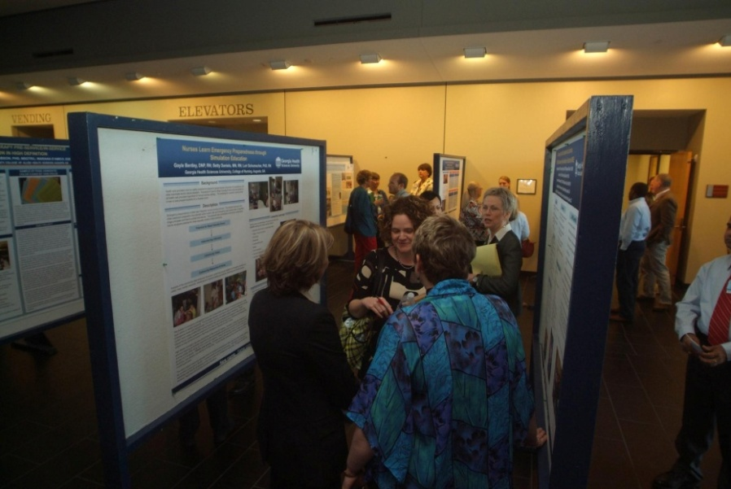
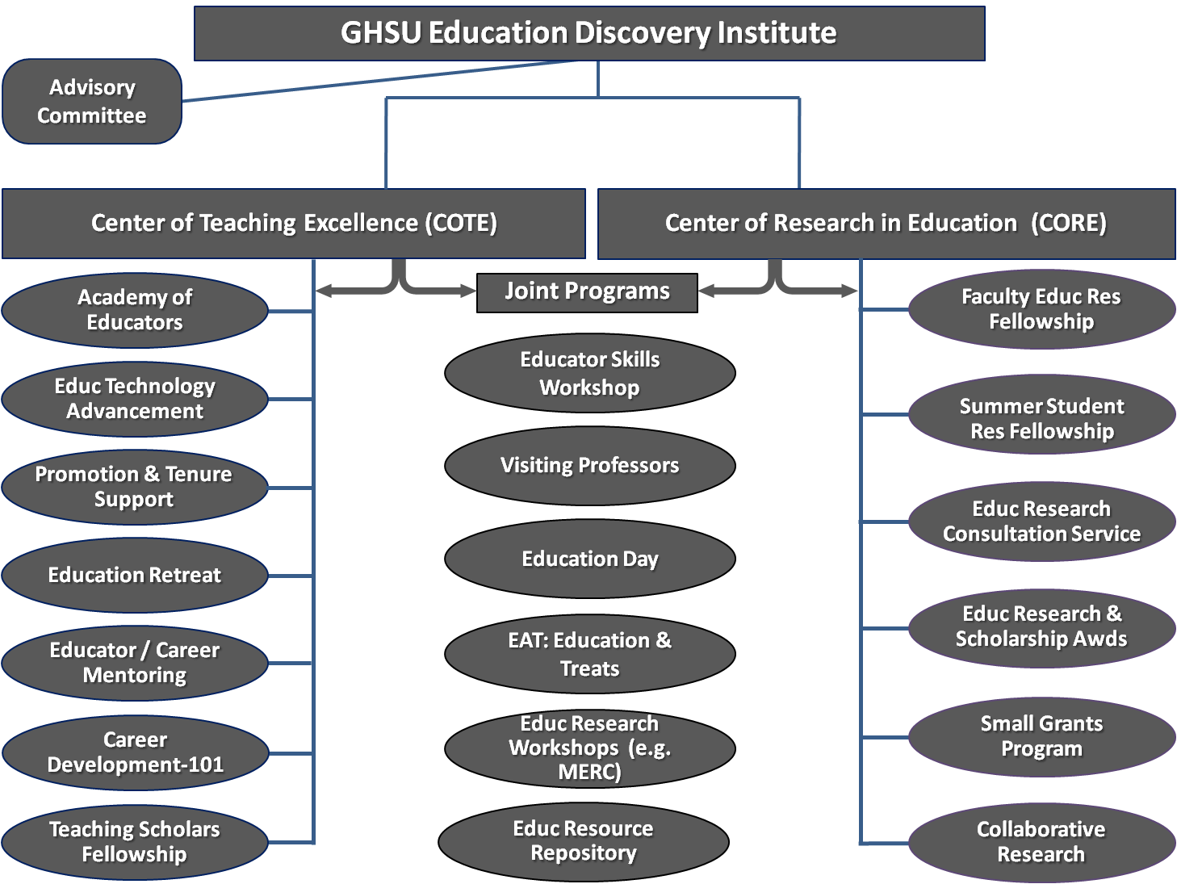
FORMATION OF AN EDUCATION DISCOVERY INSTITUTE (EDI) WITHIN AN ACADEMIC HEALTH CENTER: OPPORTUNITIES AND CHALLENGES
Lara M. Stepleman, Peggy J. Wagner, Andria M. Thomas, & Ruth-Marie E. Fincher
Education Discovery Institute
Medical College of Georgia at Georgia Health Sciences University, Augusta, GA
PURPOSE
METHOD
Outcomes 2009-2011
Conferences
22 Accepted Abstracts
7 Pending
Grants
8 Submitted
2 Received
3 Pending
Manuscripts
4 Published
1 in Press
1 under Review
EDI Research Fellows
2 Graduated
3 Current
GHSU Education Outreach
8 Visiting Professors
8 Ed. Research Workshops
2 Grand Rounds
Awards Made
5 Small Grant Awards
2 Ed. Research & Scholarship Awards
Membership
28 Inaugural Members
The Education Discovery Institute (EDI) was founded as one of six “Discovery Institutes” at Georgia Health Sciences University (GHSU) to facilitate the development, implementation, and dissemination of innovative, nationally impactful health sciences education scholarship. Our goal is to describe the development of the Education Discovery Institute at GHSU including :
Initial planning
Program development
Programming and scholarship outcomes at 18 months
Challenges to date
Applicability of the Institute model to other settings
EDI Development Phase
2008-2009
Formed a Planning Committee
Performed a SWOT Analysis
EDI Startup Phase
2009-2010
Formed Initial EDI Team
Performed Outreach & Education to GHSU Community
EDI Expansion Phase
2011-Present
Incorporate all GHSU Colleges into EDI Programs
Cultivate an Ed. Research Funding Portfolio
Created a Mission Statement & Set of Core Values
Launched Inaugural EDI Programs
Commenced with EDI Research Program
Increase EDI Visibility Regionally & Nationally
Grow EDI Team & Refine Programs & Focus
Established an Organizational Structure
BACKGROUND
In 2008, the Dean of the School of Medicine charged a planning team of educators and educational researchers to develop an educational discovery institute that paralleled other translational science discovery institutes forming within the Institution. The EDI was developed to advance GHSU’s reputation for scholarly research and career development in education though:
RESULTS
Present Day EDI Program Schematic
Educational Research Poster Session at GHSU Education Discovery Day, 2011
Developing educational discovery that enhances learning & improves patient outcomes
Applying rigorous methodology to the study of educational research questions
Using a team approach and university-wide collaboration
Fostering career advancement of faculty based on educational scholarship and discovery
Building an external network of collaborators and funding portfolio
Making Good Teachers (T1)
The Educational “Bench”
Making Good Clinicians (T2)
The Educational “Bedside”
Making Healthy Communities (T3)
The Educational “Community”
CONCLUSIONS
The EDI serves as a unique model, providing guidance on educational scholarship to faculty throughout the Institution while simultaneously becoming a highly active and prosperous research entity unto itself. Challenges include recruiting faculty desiring an educational research career, finding funding for educational research, and identifying qualified mentors to supervise faculty and students. In 2011, the EDI was charged to become a Georgia Health Sciences University-wide endeavor. This charge, an indication of perceived value, creates new opportunities for collaboration and impact, and heightens the importance of addressing the challenges to maximize the opportunity for positive impact.
.
.
EDI Translational Science Model
Presented at the Southern Group on Educational Affairs Conference, Houston, TX 04/15/2011

