Slide 1
Resilience and Wellness Training: Study Results with Pediatric Residents
Alex Mabe, Ph.D.
Michael Rollock, Ph.D.
Department of Psychiatry and Health Behavior
Medical College of Georgia/Augusta University

Slide 2
Disclosures
“I have no actual or potential conflicts of interest in relation to this program or presentation.”

Slide 3
Presentation Objectives:
Objective 1: Participants will be more informed regarding the extent of physician stress and burnout and their effects on patient care.
Objective 2: Participants will be able to discriminate between problem-based strategies for reducing physician stress and burnout versus positive psychology based approaches to enhancing physician well being.
Objective 3: Participants will be able to better identify and participate in the design of strategies for improving physician resilience and wellness using positive psychology based approaches.

Slide 4
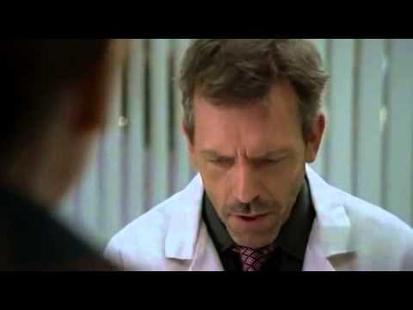
Being a Doctor Can be Difficult
https://www.youtube.com/watch?v=nvwR74XpKUM
Notes:
Long work days, high case loads, time pressures, poor sleep, high performance expectations, fears of competency, changing roles, and challenging patients such as…
Suffering and Dealing with death. "Judgments that lead to death are wrong."
Making mistakes/malpractice. “One can and should be doing more.”
Loneliness
Self-critical attitudes. "Self-sacrifice is an important part of being a physician.“ "I am responsible to meet the needs of others.”
Poor work relationships - "Everyone should respect me and like me.”
"Sacrifice now will eventually lead to rewards of an enjoyable and fulfilling life."

Slide 5
Leading Causes of Physician Stress
Rosenstein, 2012

Slide 6
Leading Causes of Physician Stress - continued
Rosenstein, 2012

Slide 7

Impact of Stress on Physicians
54% of U.S. Physician experience symptoms of burnout
(loss of enthusiasm for work, feelings of cynicism, low sense of accomplishment)
“The joy of practicing medicine is gone.”
“I hate being a doctor… I can’t wait to get out.”
“I can’t tell you how defeated I feel.”
“I am no longer a physician but the data manager…”
Burnout rates twice the rate of the general population
Shanafelt, Hasan, Dyrbye, et al., 2015

Slide 8
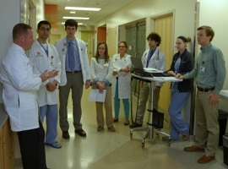
What about the Residents?
Compared to medical students and faculty, residents are faring worse in exercise, sleep, seatbelt use, and overall wellness
High prevalence and consistency of burnout across the breadth of residency training programs:
Burnout Rates Ranging from 27% to 90% (Pediatrics = 74%)
Lefebvre, 2012
Notes:
Residents eat poorly, have less sleep, exercise less, poorer quality of family interactions.

Slide 9

Impact of Physician Stress/Burnout
Irritability/anger with staff and patients
Poor patient satisfaction and adherence to physician recommendations
Reduced standards of patient care
More likely to prescribe inappropriate medications
Reports of increased medical errors
Worse clinical outcomes
Bodenheimer & Sinsky, 2014; Wallace, Lemaire, & Ghali, 2009

Slide 10

Meeting the Needs – So far
Surveys of physicians consistently indicate that they have limited access to programs to deal with stress and burnout
Physicians experience hesitancy to participate in the traditional offerings of more problem-focused interventions
High dropout rates have been reported in stress management programs for physicians
Stress management interventions for physicians may not be effective beyond the intervention period
Awa, Plaumann, & Walter, 2010 ;Ey, Moffit, Kinzie, Choi, & Girard, 2013; Van Wyk & Pillay-Van Wyk,2010
Notes:
Physician wellness is complex and multifaceted: individual, professional, and organizational factors all impact a physician’s ability to be well.
Individually physician do not take good care of themselves in regard to health behaviors and seeking treatment when needed. They often rely on denial and avoidance as coping strategies, there is a poor record for mutual support and feedback, and too often there is a conspiracy of silence which deters doctors from talking about their concerns.

Slide 11

Resilience Strategies of Experienced Physicians
Found job-related sources of gratification
Leisure time activities to reduce stress
Cultivation of relationships with colleagues, family, friends
Defining boundaries and limiting work hours
Proactive engagement with the limits of skills, complications, and treatment errors
Cultivating professionalism
Self-Organization
Personal Reflection and useful attitudes
Spiritual practices
Zwack & Schweitzer, 2013
Notes:
Showing interest in the person behind the symptoms
Establishing good relationships between doctor and patient
Enjoying the intellectual challenge of medicine.
Continuing education, literature.
Creation of routines and structure to deal with bureaucracy
Attitudes – Acceptance and realism
Attitudes – Recognizing when change is necessary
Appreciating the good things

Slide 12

Review of Wellness Programs for Residents
Programs to combat resident burnout exist but few published trials of residency-based wellness/resilience curricula
Focus of research has been on stress reduction in practicing physicians
mindfulness-based or cognitive-behavioral
Components or curricular model for an effective medical residency Wellness & Resilience curriculum still in very early stages of exploration
Irving, Dobkin, & Park, 2009; Place & Talen, 2013; Runyan, Savageau, Potts, & Weinreb, 2016
Notes:
Despite numerous reports of residency burnout, very few published trials of residency-based wellness curricula exist.
The limited research has mostly focused on practicing physicians and emphasizes either mindfulness-based or cognitive-behavioral stress reduction.
The few studies conducted with residents don't address burnout prevention or offer clear evidence of effectiveness.
The specific components or curricular model for an effective medical residency wellness curriculum remain unclear.
Runyan, C., Savageau, J. A., Potts, S., & Weinreb, L. (2016). Impact of a family medicine resident wellness curriculum: a feasibility study. Medical Education Online, 21, 10.3402/meo.v21.30648. http://doi.org/10.3402/meo.v21.30648

Slide 13
Review of Wellness Programs for Residents
AMA created online module called, “Physician wellness: preventing resident and fellow burnout”
Based on lessons learned by successful residency wellness programs.
Focus on 5 areas:
Nutrition
Emotional Health
Preventive Care
Financial Health
Mindset & behavior
https://www.stepsforward.org/modules/physician-wellness
Notes:
Nutrition. Despite hectic and often irregular schedules, residents need healthful food options and scheduled time to eat. Physician authors of the STEPS Forward module suggest that once residency programs have formed a wellness team, a focus point for the team should be ensuring that residents have nutritious food available while they are on the job.
Fitness. Staying physically active is an important key to supporting good health, but it can be tough to do with all the demands placed on residents’ time. The module recommends that training programs should make sure residents have free access to a gym that is located in or near the medical center to remove some of the barriers to staying fit.
Emotional health. Residency programs should support wellness tactics that residents can apply on an individual level, including identifying personal and professional conflicts, nurturing relationships, and practicing mindfulness-based stress-reduction techniques. The module advises that the wellness team should encourage trainees and empower them to seek and offer help as needed. Another suggestion is to develop a physician support group for trainees and faculty members.
Preventive care. As a medical professional, you know the importance of preventive care for keeping patients healthy. But do you take the time to make sure you’re getting the well care you need, such as keeping regular appointments with your primary care physician and dentist? The module recommends that program leadership commit to giving trainees an occasional weekday afternoon off for personal meetings or their own doctor appointments.
Financial health. As a resident, you most likely have a limited income, massive med school debt and maybe even a growing family to support. Making sure that you’re financially secure in your day-to-day activities and prepared for unexpected events is an important part of maintaining peace of mind and ensuring future wellness. The module suggests that one way residency programs can help trainees with financial health is to bring in a financial counselor for informal discussions with interested residents.
Mindset and behavior adaptability. Understanding how to thrive in your environment is essential. The module advises that residency programs help their trainees learn techniques to adapt their daily routine around factors that are outside of their control, such as their work schedules.

Slide 14
Review of Wellness Programs for Residents
Recent study conducted at Family Residency program suggested a different set of components for a successful residency wellness program.
Focuses on 4 areas:
Concrete resources
Positive conversations
Curriculum
Control
Place & Talen, 2013

Slide 15

Review of Wellness Programs for Residents
Workplace-driven Interventions | Individual-driven Interventions
Education about burnout | Interpersonal professional relations
Workload modifications | Meditation (e.g., mindfulness practice)
Increasing the diversity of work duties | Counseling
Stress management training | Physical fitness (e.g., yoga)
Mentoring | Nutrition
Emotional intelligence training | Peer Support
Wellness workshops | Other (reflective writing, spiritual activities, scheduled daily rest, music, massage, time in nature)
*Students often resist wellness programs because of the
potential stigma associated with self-care techniques.
IsHak, Lederer, Mandili, Nikravesh, Seligman, Vasa, & Bernstein, 2009

Slide 16
Review of Wellness Programs for Residents
Existing lit predominantly defines physician and resident wellness as a lack of burnout
Minority of studies examine causes & effects of positive wellness indicators (e.g., high perceived quality of life)
Those that have suggest that positive indicators independently predict outcomes (e.g., empathy, pt care)
Status quo of measuring burnout alone as an indicator of wellness must change if we are to move toward primary and secondary prevention efforts.
To do this, we must move beyond the pathological focus and develop a shared strength-based definition of physician and resident wellness
Thomas et al., 2007; Tucciarone, 2009

Slide 17
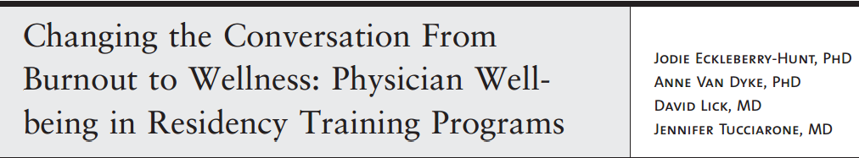
Physician and Resident Wellness: A Positive Psychology Approach
A positive psychology intervention (PPI) is defined as a psychological intervention (training, exercise, therapy) primarily aimed at raising positive feelings, positive cognitions or positive behavior as opposed to interventions aiming to reduce symptoms, problems or disorders.
Bolier et al., 2013; Tucciarone et al., 2009
Notes:
William Beaumont Hospitals, Troy Family Medicine Residency Program

Slide 18
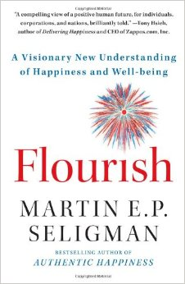
Flourishing
Living "within an optimal range of human functioning, one that connotes goodness, generativity, growth, and resilience.”
Flourishing is the opposite of both pathology and languishing (living a life that feels hollow and empty).
Seligman, 2011

Slide 19
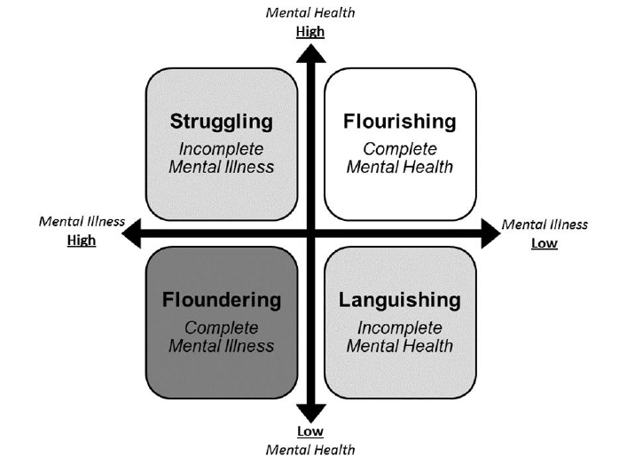
Absence of psychopathology ≠ Presence of Positive Wellbeing
Although related to mental illness, positive mental health is a distinct indicator of mental well-being that is reliably assessed with the MHC-SF
Keyes, 2007, 2008; Lamers et al. 2011
Notes:
Keyes, C. L. M. (2007). Promoting and protecting mental health as flourishing: A complementary strategy for improving national mental health. American Psychologist, 62(2), 95-108.
Abstract
This article summarizes the conception and diagnosis of the mental health continuum, the findings supporting the two continua model of mental health and illness, and the benefits of flourishing to individuals and society. Completely mentally healthy adults--individuals free of a 12-month mental disorder and flourishing--reported the fewest missed days of work, the fewest half-day or greater work cutbacks, the healthiest psychosocial functioning (i.e., low helplessness, clear goals in life, high resilience, and high intimacy), the lowest risk of cardiovascular disease, the lowest number of chronic physical diseases with age, the fewest health limitations of activities of daily living, and lower health care utilization. However, the prevalence of flourishing is barely 20% in the adult population, indicating the need for a national program on mental health promotion to complement ongoing efforts to prevent and treat mental illness. Findings reveal a Black advantage in mental health as flourishing and no gender disparity in flourishing among Whites.

Slide 20
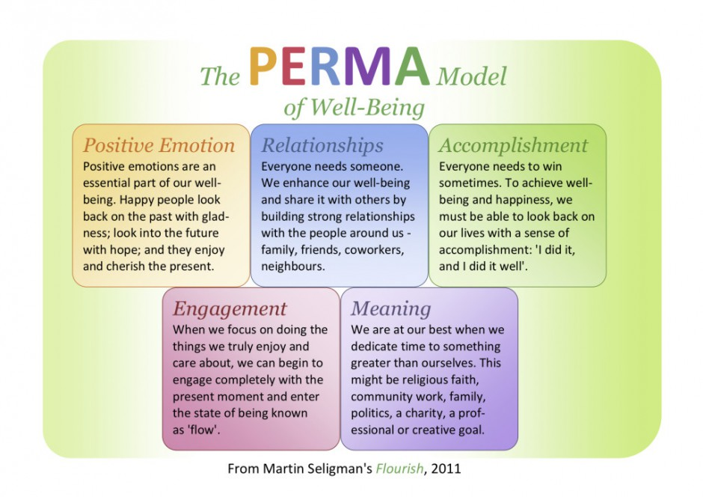

Slide 21
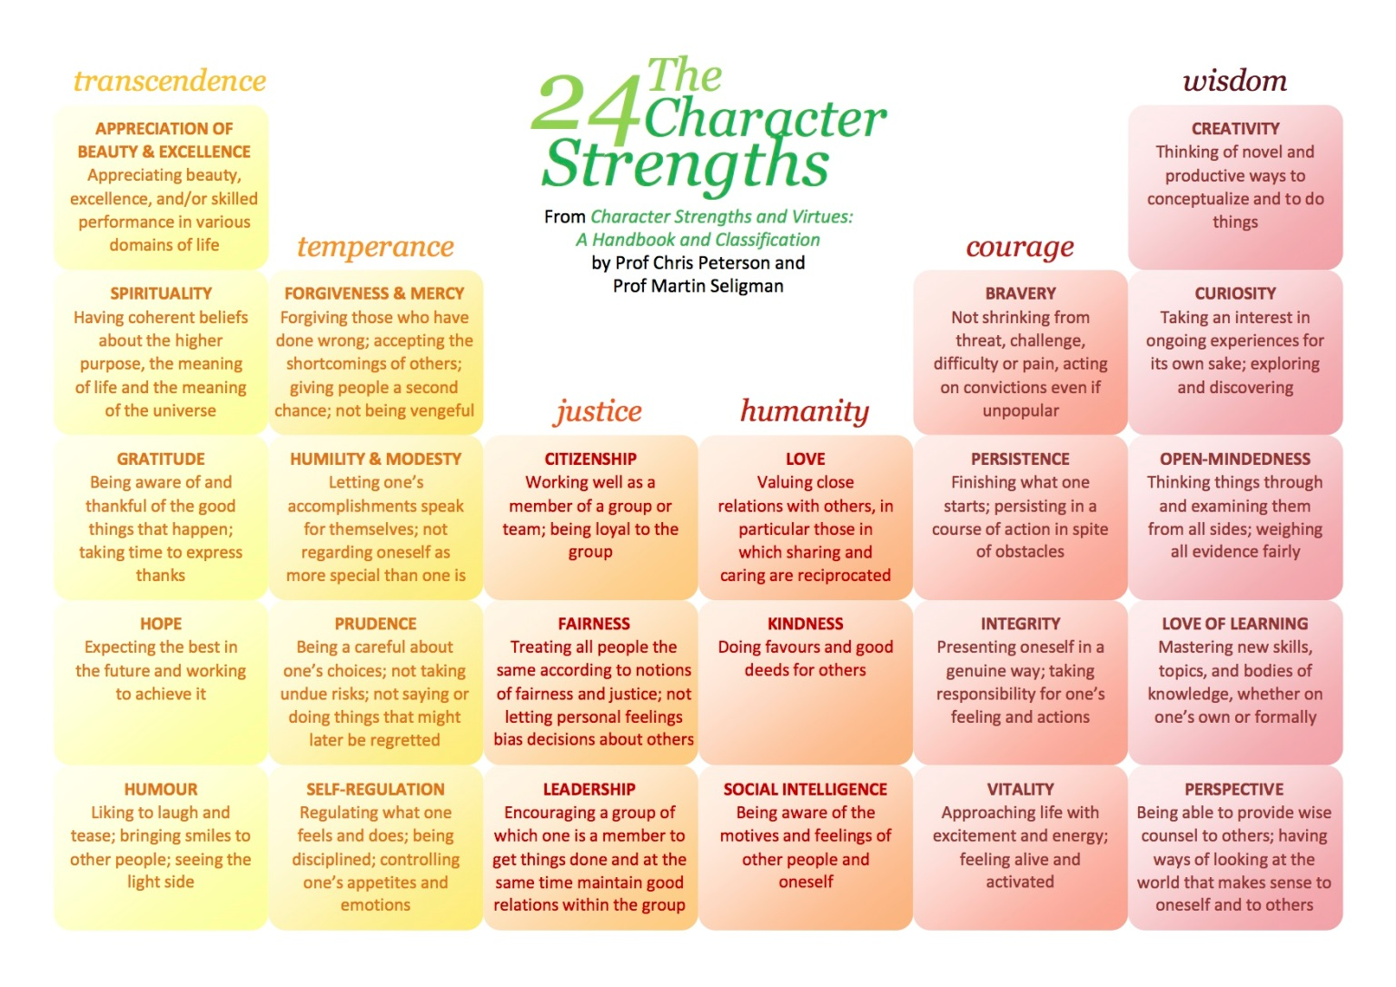
Character Strengths

Slide 22
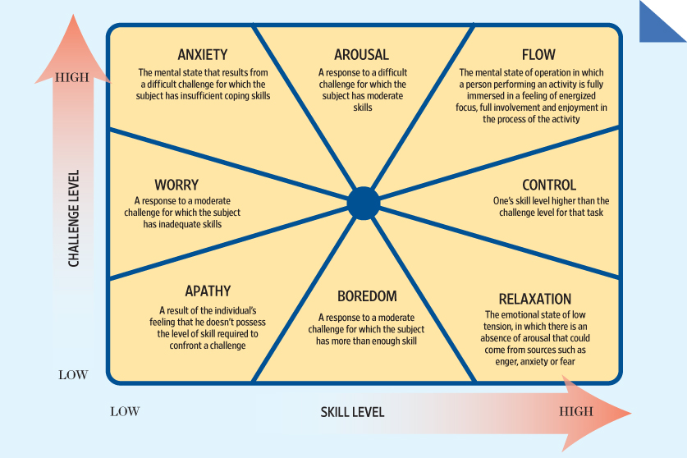

Slide 23
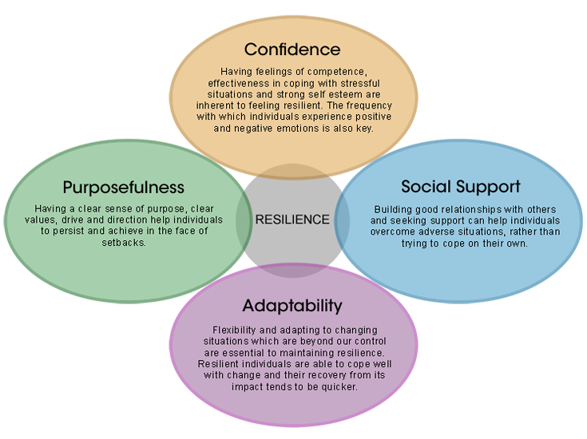

Resilience
Resilience refers to a dynamic process encompassing positive adaptation within the context of significant adversity.
Resiliency programs can effectively serve to meet accreditation requirements while fostering residents' abilities to balance personal and professional demands.
Brennan & McGrady, 2015; Luthar, Cicchetti, & Becker, 2000

Slide 24
Designing the Wellness Curriculum
Content
Learners
Instructors
Teaching Strategies
Outcomes
Content that needs to be taught
Construct of Positive Psychological Well-being
Parsimonious model of the processes that promote well-being (PERMA)
Positive Emotions
Engagement
Relationships
Meaning
Accomplishments
Attitudes that promote:
Hopefulness about well-being in a career in medicine
Change is needed and is possible
Cultivation that physician colleagues can and should share with and support one another
Wellness enhancing competencies
E.g., Using activities that foster positive emotions. Connecting with colleagues through expressing positive feelings

Slide 25
Designing the Wellness Curriculum
Content
Learners
Instructors
Teaching Strategies
Outcomes
Targeted Learners
Empirically minded – reliance on science
Indoctrinated in illness model of health/well-being
Adult learners
Have a foundation of life experiences and knowledge
Are relevancy oriented
Are goal-directed
Autonomous and self-directed in their learning style
(Bowen, 2006; Bussema & Nemec, 2006; Davies, 2000; Stuart et al., 2004; Zisook et al., 2005)
Notes:
Empirically minded – scientific evidence that supports the principles
e.g., positive emotions seemed to be about facilitating approach behavior or continued action (Fredrickson & Cohn, 2008)
Indoctrination in illness model – emphasis that well-being is more than absence of stress, illness… as illustrated by individuals flourishing in the context of stress.
Adult learners:
Foundation of life experience - An Appreciative Inquiry of Your Work
Relevancy - Daily/Weekly job crafting activity
Goal directed – Broadening and expanding
Autonomous – Active learning exercises

Slide 26
Designing the Wellness Curriculum
Content
Learners
Instructors
Teaching Strategies
Outcomes
Characteristics of Instructors
Provider-Driven Training – similar educational and clinical experience
Passion for the material that conveys the emotions and the attitudes
Personally experienced processes that promote well-being
Burke & Hutchins, 2008; Bussema & Nemec, 2006; Irby & Papadakis, 2001; Stuart et al., 2004; Sutkin et al., 2008.
Notes:
Educational research has consistently demonstrated that effective teachers are knowledgeable, establish clear goals of the instruction, and are able to present key information in an organized fashion using familiar and understandable language (Sutkin, Wagner, Harris, & Schiffer, 2008; Towler & Dipboye, 2001). Moreover, effective teachers are generally approachable, open-minded, show patience and respect for students, care about students’ success and are fair, show enthusiasm and humor, and intentionally engage with their students to establish rapport (Benson et al., 2005; Sutkin et al., 2008). In clinical contexts, the experience and expertise of the instructor play important roles in eliciting the attention of learners and helping them learn and retain knowledge and skills obtained during instruction (Burke & Hutchins, 2008; Sutkin et al., 2008).
Clinical teaching in general is demanding, and those who do it well have passion for their work as well as a high level of technical skill (Bussema & Nemec, 2006; Irby & Papadakis, 2001; Stuart et al., 2004)
With this personal experience, the instructor would have the advantage of having a greater appreciation for the challenges involved in change and could better direct the learner in addressing these challenges. A coping model of a clinician-instructor who has actively engaged in and succeeded in transforming his or her practice.

Slide 27
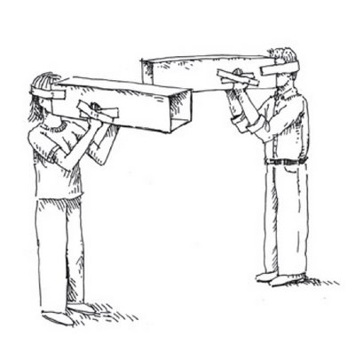
Designing the Wellness Curriculum
Content
Learners
Instructors
Teaching Strategies
Outcomes
Teaching Strategies
Multiple teaching strategies
E.g., video, stories, didactics, discussion questions, self-reflection exercises, job crafting activities, email prompts
“Less is more”
Explicitly address knowledge, attitudes, and competencies (specific actions)
E.g., impact of positive emotions induction, An Appreciative Inquiry of Your Work, recommended actions of “savoring” or “Three Things/Blessings”
Personal stories
Reminders/Prompts
Chow, Cichocki, & Leff, 2009; Grol & Grimshaw, 2003; Lyon et al., 2011; Stuart et al., 2004
Notes:
As Bussema and Nemec (2006, p. 315) stated, “… making lasting changes in the behavior of mental health practitioners is astoundingly difficult, and implementing new practices in mental health systems is painfully slow.” In examining original studies and systematic reviews regarding interventions to change medical practices across disciplines, the most robust and consistent finding has been that single teaching strategies are ineffective in changing practice behaviors (Grol & Grimshaw, 2003; Lyon et al., 2011). Instead, changes in medical practice are more likely when multiple strategies are implemented (Chow, Cichocki, & Leff, 2009; Grol & Grimshaw, 2003).
Stories convey struggles and emotions that stir up affect in the learner that can more effectively influence beliefs, attitudes and behaviors than mere presentation of principles. Stories provide vivid pictures of coping models . And yet in those stories can be found partners in care who had the courage and determination to endure hardships and setbacks in order to achieve lives of purpose and meaning.

Slide 28
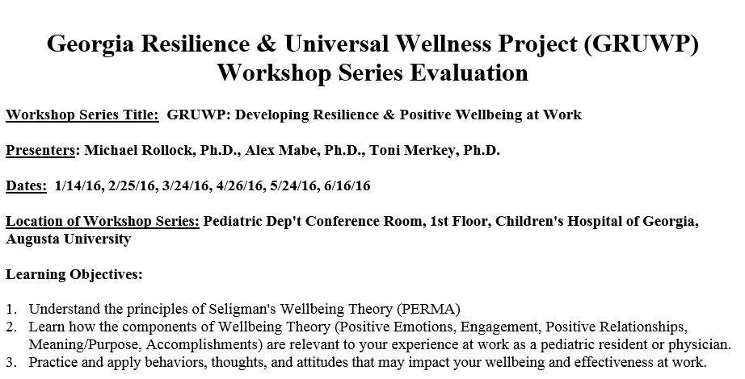

Slide 29
Designing the Wellness Curriculum
Content
Learners
Instructors
Teaching Strategies
Outcomes
Outcomes
Preliminary Workshop data and Qualitative Responses
13 endorsed “I gained one ore more specific ideas that I can implement in my area of practice.”
10 endorsed “It may help me do a better job.”
5 endorsed “I learned a new approach to my practice”
1 endorsed “I do not see the impact of this course on my job”

Slide 30
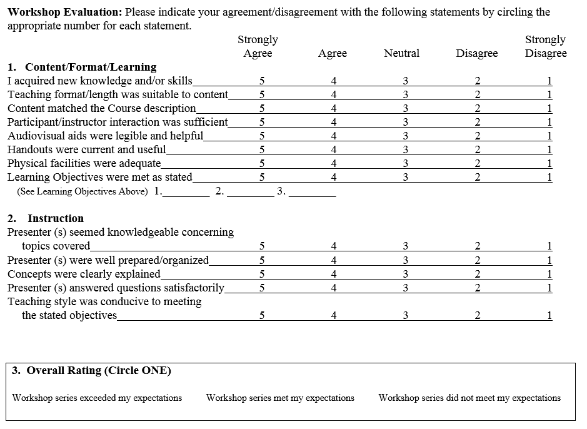

Slide 32
Comments/Suggestions for this workshop series
“This was fantastic - Thank you to all the speakers. It means a lot that you all are not only concerned for our wellbeing, but are willing to take the time to help us improve it.”
“Fantastic & motivating series. It was refreshing to take a moment for self-reflection.”
“I think this series could be expanded to include other residency programs as well.”
“Great! More case based scenarios to enact new knowledge learned, probably toward end of session.”
“Thoroughly enjoyed this series. Once every couple months is perfect. Thank you for taking the time to do this!”
“Really liked the videos. Speakers were enthusiastic & engaging.”
“For skeptics such as myself, it would be helpful to gain my Attention/Engagement if more time were devoted to discussing why "hapiness" [sic] and "wellbeing" is a useful goal.”

Slide 33
Conclusions and Future Directions
Burnout is common in residents and is associated with decreased resident well-being and career satisfaction.
Burnout is associated with self-reported patient care practices that are suboptimal
Residents appear to enjoy and benefit from programmatic approach that includes strength-based approaches to well-being
Future iterations will utilize pre-post measurement of well-being & burnout variables and their relationship to outcomes of interest
Future iterations will include online and student-led components
Initiate a larger discussion about creating a culture of wellness

Slide 34
Multiple Choice Question
The Resident Training Director determines that the current class of residents is struggling with stress and overall dissatisfaction with their work as residents. Which of the following steps would be the most promising strategies to improve resilience and overall wellness of the residents:
Refer the residents to a stress management class being provided by the Human Resources department.
Provide training on how to find job-related sources of gratification.
Administer a screening questionnaire for stress related problems and provide mental health referral information for those residents scoring high on stress symptoms.
Within the department set up incentives for individual residents’ initiatives to reduce their own stress.

Slide 35
References
Awa, W. L., Plaumann, M., & Walter, U. (2010). Burnout prevention: A review of intervention programs. Patient education and counseling, 78(2), 184-190.
Bodenheimer, T., & Sinsky, C. (2014). From triple to quadruple aim: care of the patient requires care of the provider. The Annals of Family Medicine, 12(6), 573-576.
Bolier, L., Haverman, M., Westerhof, G. J., Riper, H., Smit, F., & Bohlmeijer, E. (2013) Positive psychology interventions: A meta-analysis of randomized controlled studies. BMC Public Health, 13(119), 1-20
Bowen, J. L. (2006). Educational Strategies to Promote Clinical Diagnostic Reasoning. New England Journal of Medicine, 355(21), 2217-2225. doi: doi:10.1056/NEJMra054782
Brennan, J. & McGrady, A. (2015). Designing and implementing a resiliency program for family medicine residents. International Journal of Psychiatric Medicine, 50(1), 104-114.
Burke, L. A., & Hutchins, H. M. (2008). A study of best practices in training transfer and proposed model of transfer. Human Resource Development Quarterly, 19(2), 107-128.
Bussema, E., & Nemec, P. (2006). Effective teaching. Psychiatric Rehabilitation Journal, 29(4), 315-317.
Chow, C., Cichocki, B., & Leff, H. S. (2009). The Support for Evidence-Based Training Strategies. Psychiatric Rehabilitation Journal, 33(2), 156-159.
Davies, P. (2000). Approaches to evidence-based teaching. Medical teacher, 22(1), 14-21.
Ey, S., Moffit, M., Kinzie, J. M., Choi, D., & Girard, D. E. (2013). “If You Build It, They Will Come”: Attitudes of Medical Residents and Fellows About Seeking Services in a Resident Wellness Program. Journal of graduate medical education, 5(3), 486-492.
Grol, R., & Grimshaw, J. (2003). From best evidence to best practice: effective implementation of change in patients' care. The Lancet, 362(9391), 1225-1230.
Hershberger, P.J. (2005). Prescribing happiness: Positive psychology and family medicine. Family Medicine, 37, 630-634.
Irby, D. M., & Papadakis, M. (2001). Does good clinical teaching really make a difference? The American journal of medicine, 110(3), 231-232.
Irving J, Dobkin P, & Park J. (2009). Cultivating mindfulness in healthcare professionals: a review of empirical studies of mindfulness based stress reduction. Complementary Therapies in Clinical Practice, 15, 61–66.
IsHak, W. W., Lederer, S., Mandili, C., Nikravesh, R., Seligman, L., Vasa, M., … Bernstein, C. A. (2009). Burnout During Residency Training: A Literature Review. Journal of Graduate Medical Education, 1(2), 236–242. http://doi.org/10.4300/JGME-D-09-00054.1

Slide 36
References
Keyes, C. L. M. (2007). Promoting and protecting mental health as flourishing: A complementary strategy for improving national mental health. American Psychologist, 62(2), 95-108.
Keyes, C.L.M., Wissing, M., Potgieter, J.P., Temane, M., Kruger, A., & van Rooy, S. (2008). Evaluation of the mental health continuum-short form (MHC-SF) in Setswana-speaking South Africans. Clinical Psychology & Psychotherapy, 15(3), 181–192.
Lamers, S. M.A., Westerhof, G. J., Bohlmeijer, E. T., ten Klooster, P. M. and Keyes, C. L.M. (2011), Evaluating the psychometric properties of the mental health Continuum-Short Form (MHC-SF). Journal of Clinical Psychology, 67: 99–110. doi:10.1002/jclp.20741
Lefebvre, D. C. (2012). Perspective: resident physician wellness: A new hope. Academic Medicine, 87(5), 598-602.
Luthar, S. S., Cicchetti, D., & Becker, B. (2000). The Construct of Resilience: A Critical Evaluation and Guidelines for Future Work. Child Development,71(3), 543–562.
Lyon, A. R., Stirman, S. W., Kerns, S. E., & Bruns, E. J. (2011). Developing the mental health workforce: review and application of training approaches from multiple disciplines. Administration and Policy in Mental Health and Mental Health Services Research, 38(4), 238-253.
Place S., & Talen M. (2013). Creating a culture of wellness: conversations, curriculum, concrete resources, and control. International Journal of Psychiatric Medicine, 45, 333–344.
Rosenstein, A. H. (2012). Physician stress and burnout: prevalence, cause, and effect. Paper presented at the American Academy of Orthopedic Surgeons.
Runyan, C., Savageau, J. A., Potts, S., & Weinreb, L. (2016). Impact of a family medicine resident wellness curriculum: a feasibility study. Medical Education Online, 21, 10.3402/meo.v21.30648. http://doi.org/10.3402/meo.v21.30648
Seligman, Martin E. P. (2011). Flourish: A Visionary New Understanding of Happiness and Well-being. Free Press.
Shanafelt, T. D., Hasan, O., Dyrbye, L. N., Sinsky, C., Satele, D., Sloan, J., & West, C. P. (2015). Changes in burnout and satisfaction with work-life balance in physicians and the general US working population between 2011 and 2014. Paper presented at the Mayo Clinic Proceedings.
Stuart, G., Tondora, J., & Hoge, M. (2004). Evidence-Based Teaching Practice: Implications for Behavioral Health. Administration and Policy in Mental Health and Mental Health Services Research, 32(2), 107-130. doi: 10.1023/B:APIH.0000042743.11286.bc
Sutkin, G., Wagner, E., Harris, I., & Schiffer, R. (2008). What makes a good clinical teacher in medicine? A review of the literature. Academic Medicine, 83(5), 452-466.

Slide 37
References
Thomas, M.R., Dyrbye, L.N., Huntington, J.L., Lawson, K.L., & Novotny, P.J., Sloan, J.A., Shanafelt, T.D., (2007). How do distress and well-being relate to medical student empathy? A multicenter study. Society of General Internal Medicine, 22, 177-183.
Tucciarone, J. (2009). Changing the Conversation From Burnout to Wellness: Physician Well-being in Residency Training Programs. Journal of Graduate Medical Education, 225.
van Wyk, B. E., & Pillay‐Van Wyk, V. (2010). Preventive staff‐support interventions for health workers. The Cochrane Library.
Wallace, J. E., Lemaire, J. B., & Ghali, W. A. (2009). Physician wellness: a missing quality indicator. The Lancet, 374(9702), 1714-1721.
Zisook, S., Benjamin, S., Balon, R., Glick, I., Louie, A., Moutier, C., . . . Servis, M. (2005). Alternate methods of teaching psychopharmacology. Academic Psychiatry, 29(2), 141-154.
Zwack, J., & Schweitzer, J. (2013). If every fifth physician is affected by burnout, what about the other four? Resilience strategies of experienced physicians. Academic Medicine, 88(3), 382-389.
Stuart, G., Tondora, J., & Hoge, M. (2004). Evidence-Based Teaching Practice: Implications for Behavioral Health. Administration and Policy in Mental Health and Mental Health Services Research, 32(2), 107-130. doi: 10.1023/B:APIH.0000042743.11286.bc
Sutkin, G., Wagner, E., Harris, I., & Schiffer, R. (2008). What makes a good clinical teacher in medicine? A review of the literature. Academic Medicine, 83(5), 452-466.
Thomas, M.R., Dyrbye, L.N., Huntington, J.L., Lawson, K.L., & Novotny, P.J., Sloan, J.A., Shanafelt, T.D., (2007). How do distress and well-being relate to medical student empathy? A multicenter study. Society of General Internal Medicine, 22, 177-183.
Tucciarone, J. (2009). Changing the Conversation From Burnout to Wellness: Physician Well-being in Residency Training Programs. Journal of Graduate Medical Education, 225.
van Wyk, B. E., & Pillay‐Van Wyk, V. (2010). Preventive staff‐support interventions for health workers. The Cochrane Library.
Wallace, J. E., Lemaire, J. B., & Ghali, W. A. (2009). Physician wellness: a missing quality indicator. The Lancet, 374(9702), 1714-1721.
Zisook, S., Benjamin, S., Balon, R., Glick, I., Louie, A., Moutier, C., . . . Servis, M. (2005). Alternate methods of teaching psychopharmacology. Academic Psychiatry, 29(2), 141-154.
Zwack, J., & Schweitzer, J. (2013). If every fifth physician is affected by burnout, what about the other four? Resilience strategies of experienced physicians. Academic Medicine, 88(3), 382-389.

