Slide 1


Assessment of a Medicine – Pharmacy Collaborative Interprofessional Education Exercise
S. Jones Miller PhD, MD, Elena Wood MD, PhD, Renee Page, MD,
Susan C Fagan, Pharm.D., Michael Fulford, PhD,
Andy Albritton, MD, Paul Wallach, MD
Medical College of Georgia and University of Georgia College of Pharmacy
Notes:
Have participants introduce if small or raise hands if large group

Slide 2
Goals and Objectives
Define Interprofessional Education in Health Sciences
State Existing Pharmacy IPE Exercises
Explain IPE Competencies
Describe the Med-Pharm IPE
Notes:
I don’t know what your objective for being here but here are mine

Slide 3
Disclosure
I have no real or apparent conflicts of interest

Slide 4
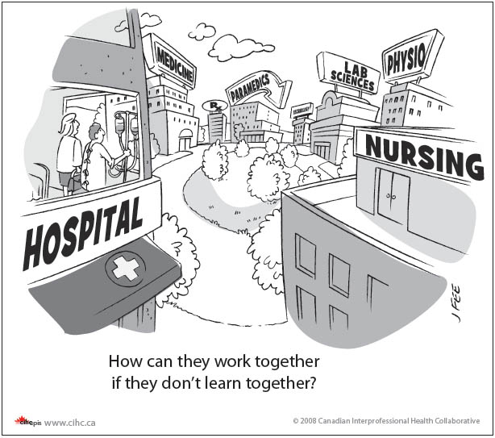
Definition of Interprofessional Education
IPE is defined as occasions , “when two or more professions learn with, from, and about each other to improve collaboration and the quality of care”
Available from www.caipe.org.uk/about-us/defining.ipe
Notes:
What Health Profession do you think you interact with most in the future?

Slide 5
Background
Accrediting bodies (LCME, ACPE) have created new standards which require Medical and Pharmacy schools to incorporate Interprofessional Education as part of their curricular offerings.
The Medical College of Georgia and the UGA College of Pharmacy have a 40+ year history of collaboration but never intentionally added joint curricular offerings.

Slide 6
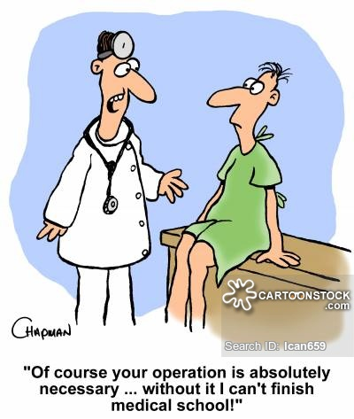
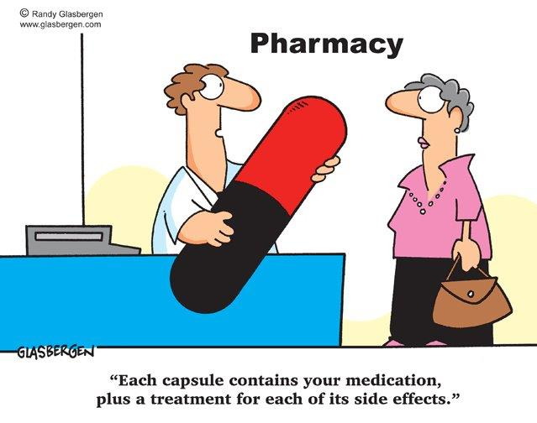
Background
M3 students have excellent patient assessment skills and P3 students have excellent knowledge of pharmacotherapy. Putting them together to discuss patients would allow both groups to learn from each other to improve patient care and understand different professional perspectives in patient care.

Slide 7
Competency Based Objectives
ACPE Standards
Standard 3.4 The graduate is able to actively participate and engage as a healthcare team member by demonstrating mutual respect, understanding, and values to meet patient care needs
Standard 11 The curriculum prepares all students to provide entry- level patient-centered care in a variety of practice settings as a contributing member of an interprofessional team. In the aggregate, team exposure includes prescribers as well as other healthcare professionals.
LCME Standards
Standard 7.9 The Faculty of a medical school ensure that the core curriculum of the medical education program prepares medical students to function collaboratively on health care teams that include health professionals from other disciplines as they provide coordinated service to patients.

Slide 8
Study Design
Observational cross-sectional study (AY 2014-15)
Participants: Third Year medical and third year pharmacy students working together in teams of 6-8 students
Total participants were 190 Medical Students and 142 Pharmacy Students
Students were from UGA College of Pharmacy and the Medical College of Georgia.
Participants were from all campuses: Augusta, Athens, Rome, Albany, and Savannah
P3 students were required to submit the completed patient case for 20% of their Pharmacotherapy grade in the Spring semester. M3 students were not graded on their participation.

Slide 9
Project Aims
Improve M3 & P3 students ability to obtain and organize patients and drug information, gathered from other health care professional students, in order to identify actual or potential drug related problems.
Develop a collaborative plan to address each drug related problem and provide justification and documentation for each
Evaluate student’s perception of IPE values and attitudes toward future inter-professional collaboration

Slide 10
Intervention
Duration of study was from January 2015 until April 30, 2015
One M3 student selects a patient who is currently on three or more prescription drugs
58 group cases were submitted (2 page document by email) twice during the study time line. A pharmacy faculty member graded all the cases.
One M3 student succinctly presents the patient. Includes pertinent history, physical test results, and diagnosis (either in person or by distance connection using Facetime, Google hangout, or Skype)
List routine and prn medications
Notes:
What do you think students might discuss in their cases?

Slide 11
Exercise
The group discussed all therapies and identified potential drug related problems. Recommendations were supported with published literature.
Discuss drug mechanism of action
Assess the appropriateness of current medications on the basis of health conditions, indication , and the therapeutic goals of each medication
Evaluate the effectiveness, safety, and affordability of each medication.

Slide 12
Exercise
Assess medication-taking behaviors and adherence to each medication
Identify each potential medication-related problem and evaluate the need for intervention
Evaluate these medications for interactions with each other or other common medications
Are there pharmacogenetic considerations?

Slide 13
Exercise
Identify 2 knowledge gaps relevant to this patient scenario
a. Identify, analyze and synthesize information relative to the gap
b. Evaluate credibility of information
c. Describe approach to information gathering
d. Provide feedback to each other on the process of information seeking
Notes:
What do you think the competencies should be for this exercise

Slide 14
IPEC Competencies
Values/Ethics
Communication
Roles/Responsibilities
Team/Teamwork

Slide 15
Specific Values/Ethics Competencies IPEC *
VE 1. Place the interest of patients and populations at the center of interprofessional health care delivery
VE4. Respect the unique cultures, values, roles/responsibilities, and expertise of other health professions
VE5. Work in cooperation with those who receive care, those who provide care, and others who contribute to or support the delivery of prevention and health services
VE9. Act with honesty and integrity in relationships with patients, families, and other team members.
VE10. Maintain competence in one’s own profession appropriate to scope of practice
https://ipecollaborative.org/uploads/IPEC-Core-Competencies.pdf

Slide 16
Specific IPE Communication Competencies IPEC
CC2. Organize and communicate information with patients, families, and healthcare team members in a form that is understandable, avoiding discipline-specific terminology when possible.
CC3. Express one’s knowledge and opinions to team members involved in patient care with confidence, clarity, and respect, working to ensure common understanding of information and treatment and care decisions
CC4. Listen actively, and encourage ideas and opinions of other team members
CC7. Recognize how one’s own uniqueness, including experience level, expertise, culture, power, and hierarchy within healthcare team, contributes to effective communications, conflict resolution, and positive interprofessional working relationships.

Slide 17
Specific Roles/Responsibilities Competencies IPEC
RR2. Recognize one’s limitations in skills, knowledge, and abilities.
RR5. Use the full scope of knowledge, skills, and abilities of available health professionals and healthcare workers to provide care that is safe, timely, efficient, effective, and equitable.
RR6. Communicate with team members to clarify each member’s responsibility in executing components of a treatment plan or public health intervention.
RR9. Use unique and complementary abilities of all members of the team to optimize patient care

Slide 18
Specific Team and Teamwork Competencies IPEC
TT3. Engage other health professionals-appropriate to the specific care situation- in shared patient-centered problem-solving
TT4. Integrate the knowledge and experience of other professions- appropriate to the specific care situation- to inform care decisions, while respecting patient and community values and priorities/preferences for care.
TT7. Share accountability with other professions, patients, and communities, for outcomes relevant to prevention and health care.

Slide 19
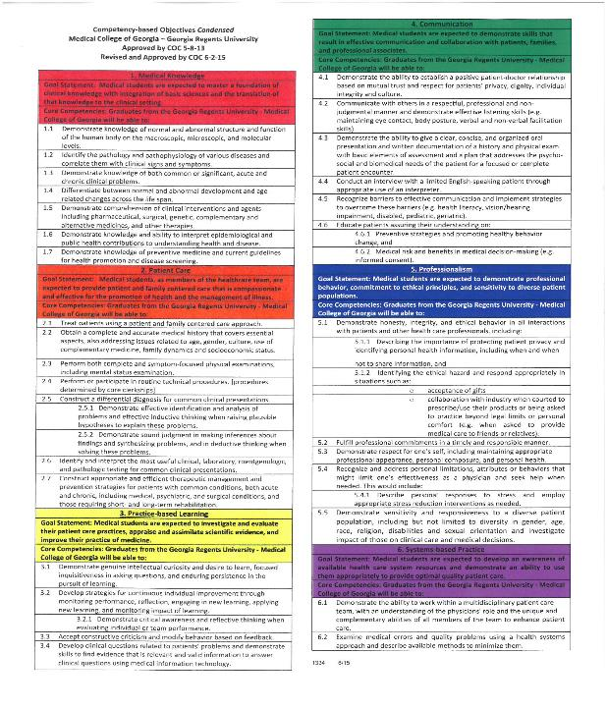
CBO Competency-Based Objectives

Slide 20
Data Collection and Analysis
Course evaluation was performed electronically, using evaluation systems of two different universities and the results were combined
Some survey questions were targeted only to medical students or pharmacy students
Deidentified Data was received and analyzed using SPSS
Only data that included Med and Pharm Students are presented , but data collected which involved only Pharm or only Med not reported

Slide 21
Results
Course evaluation by survey of which 81% (N=157) of Medical Students and 76% (N=108) of Pharmacy Students completed the Survey
Gender : Male 154, Female 153
Notes:
Who do you think was the leader of the group? Pharmacy or Medicine.

Slide 22
Results I saw myself as the leader of the group (TT5)
SD= Strongly Disagree SA= Strongly Agree
P=.000, T=-3.97
Notes:
Biased by Grading because Pharm had to take charge of exercise because of grade requirement Stat signi

Slide 23
Results The experience added to my understanding of the benefits to patients of team care (TT4)
P=.001, T=-3.53
Notes:
More pharmacy students agree and SA compared to Med Students who Disagree and SD

Slide 24
Results As a result of this experience, my confidence in working with other professionals regarding patient care improved (CC3)
P=.061, T=-1.89
Notes:
Pharm Students Confidence improved as a result of exercise Not stat sig

Slide 25
Results This experience helped improve my ability to communicate professionally and effectively with other professionals
P=.005, T=-2.87
Notes:
Stat Sig More med disagree and More Pharm agree

Slide 26
Results This experience aided in my understanding of my respective role in an Interprofessional Team (RR4)
P=.02, T=-2.36
Notes:
Stat Sig

Slide 27

Results There was discussion related to the risks of medical errors (TT7)
P=.000, T=-7.00
Notes:
Medical Errors were not discussed in the group, but Pharm Students discussed among themselves Strongest correlation we have

Slide 28
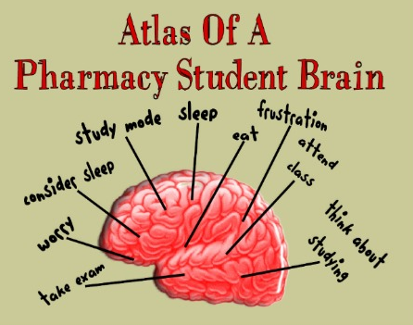

Conclusions
Med-Pharm IPE expanded to include M2 and P2 Students, other IPE exercises between M3P3 and M4P4 in process
Both Groups should be Graded to remove Bias
Further Investigation needed to understand Medical Student perception of value of exercise in team based care
Earlier introduction in Curriculum may improve perception of importance of team based care .

Slide 29
Session Code RYN55

