Slide 1
Marketing Your Student Organization
Sabrina Dunn, Marketing Coordinator
Division of Communications and Marketing

Slide 2
Marketing is…
Marketing is the activity and process for creating, communicating, and delivering opportunities that have value for customers, clients, partners, and society at large.¹
Marketing is not advertising. Advertising is paid, public, and non-personal. Marketing presents the overall picture and advertising is just a component of the overall picture.
¹ This definition was approved by the American Marketing Association Board of Directors.

Slide 3
Step 1: Create your plan
Define your mission.
Define your goals.
Develop a marketing plan.
A marketing plan is your blueprint that highlights the steps required to achieve your marketing goals.

Slide 4
Six Key Elements of a Successful Marketing Plan
Executive Summary – A concise overview of your marketing objectives and goals.
Target Audience – Who are the students you want to appeal to?
Competitors – What other organizations are similar to your own?
Unique Position – What makes your organization special?
Budget – How much will it cost to accomplish your goals vs. how much can you spend?
Action Plan – Simple yet impactful next steps to meet your goals.

Slide 5
Step 2: Communicate with tools
Flyers
Social Media
Tabling
Chalking
Apparel
Giveaways
Photo / Video

Slide 6
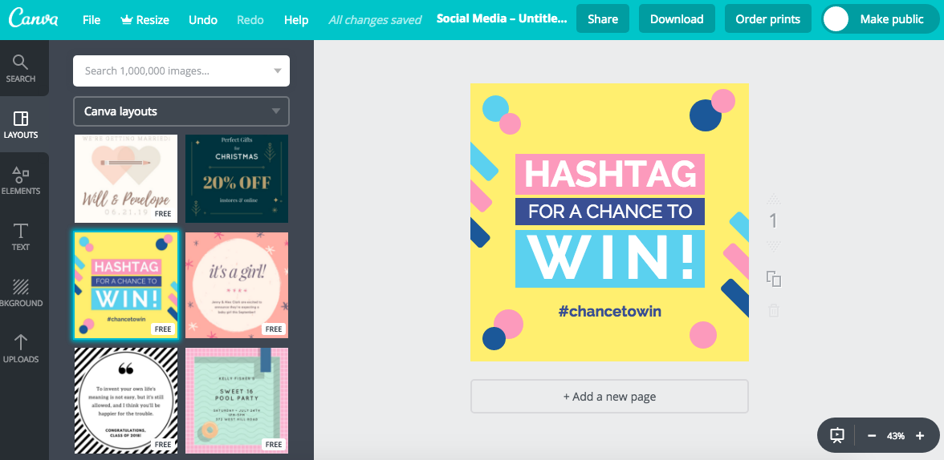
Tools and Resources
Canva – A free graphic-design tool with access to over a million photographs, graphics, and fonts.

Slide 7
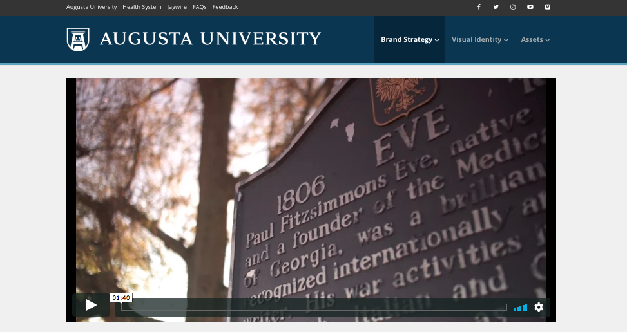
Tools and Resources
Augusta University Brand Site – Official brand guidelines, marketing assets and trusted vendors. (brand.augusta.edu)

Slide 8
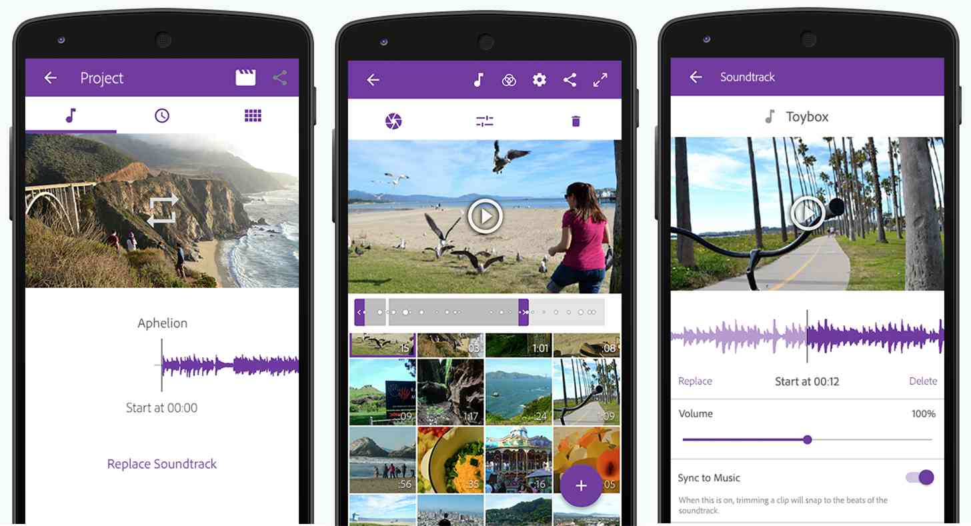
Tools and Resources
Adobe Premiere Clip – Create quality videos that can be easily shared — or easily opened in Premiere Pro CC.

Slide 9
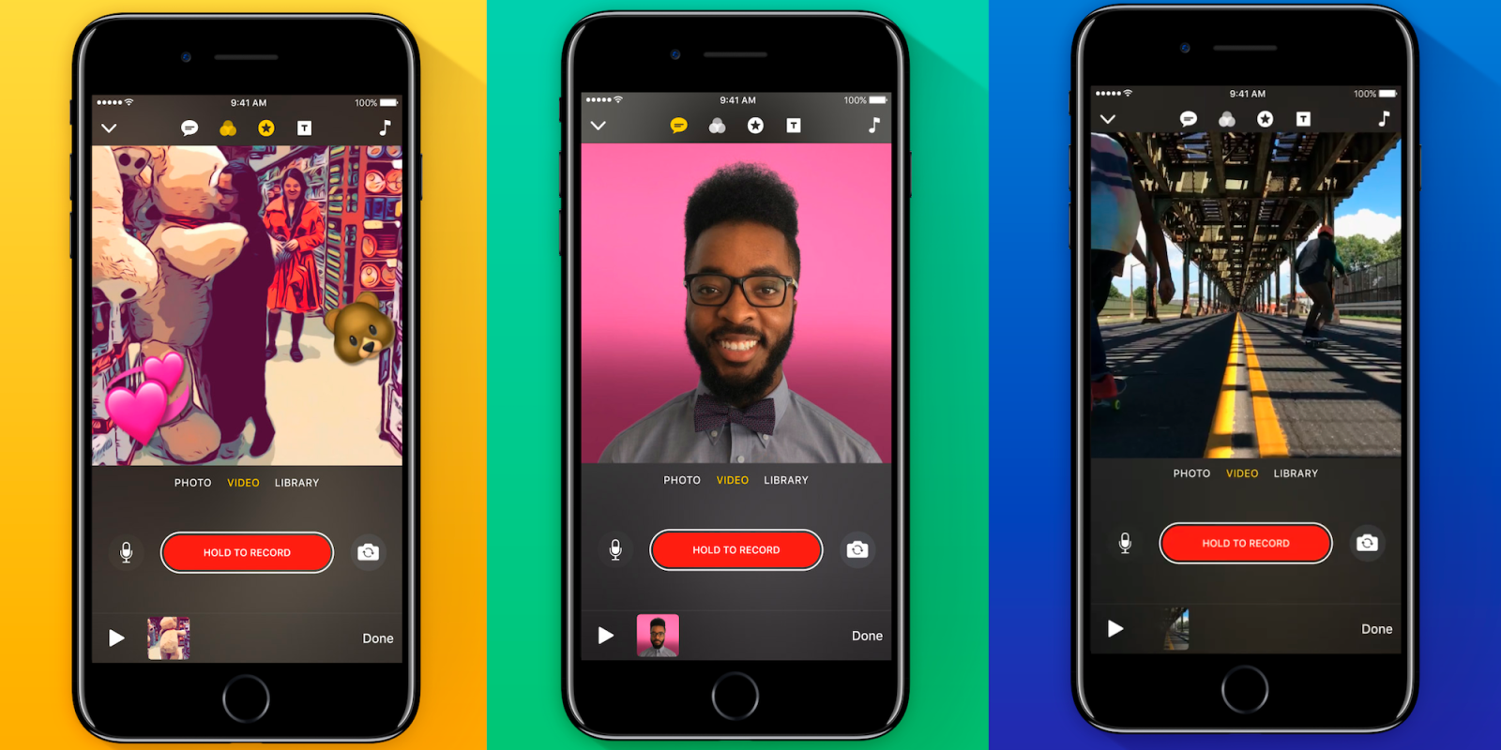
Tools and Resources
Clips – Create video message or tell a story with animated text, graphics and emoji, music, and more.

Slide 10
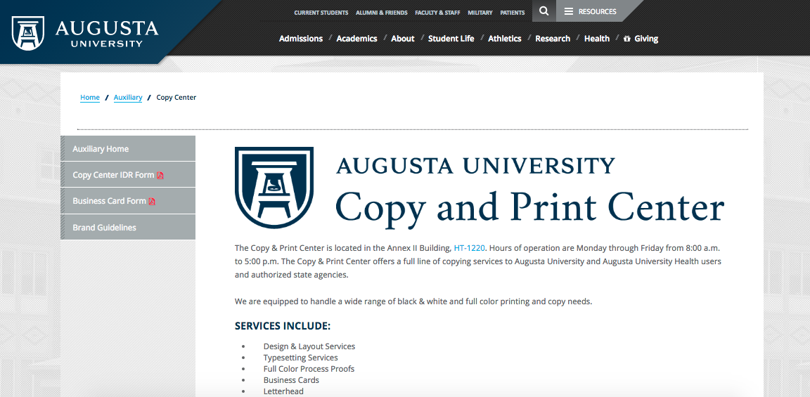
Tools and Resources
Augusta University Print Shop – Offers a wide range of black & white and full color printing and copy needs.

Slide 11
Step 3: Deliver
Campus Platforms
Jagwire (jagwire.augusta.edu)
Events Calendar (calendar.augusta.edu)
On-campus promotional sites. (stall walls, sidewalks, high-traffic locations etc.)
Social Media
Organization branded accounts (augusta.edu/social)
Rent official accounts (socialmedia@augusta.edu)

Slide 12
Questions?

Slide 13
Contact DCM
augusta.edu/dcm/request
marketing@augusta.edu
socialmedia@augusta.edu

